Slide 1

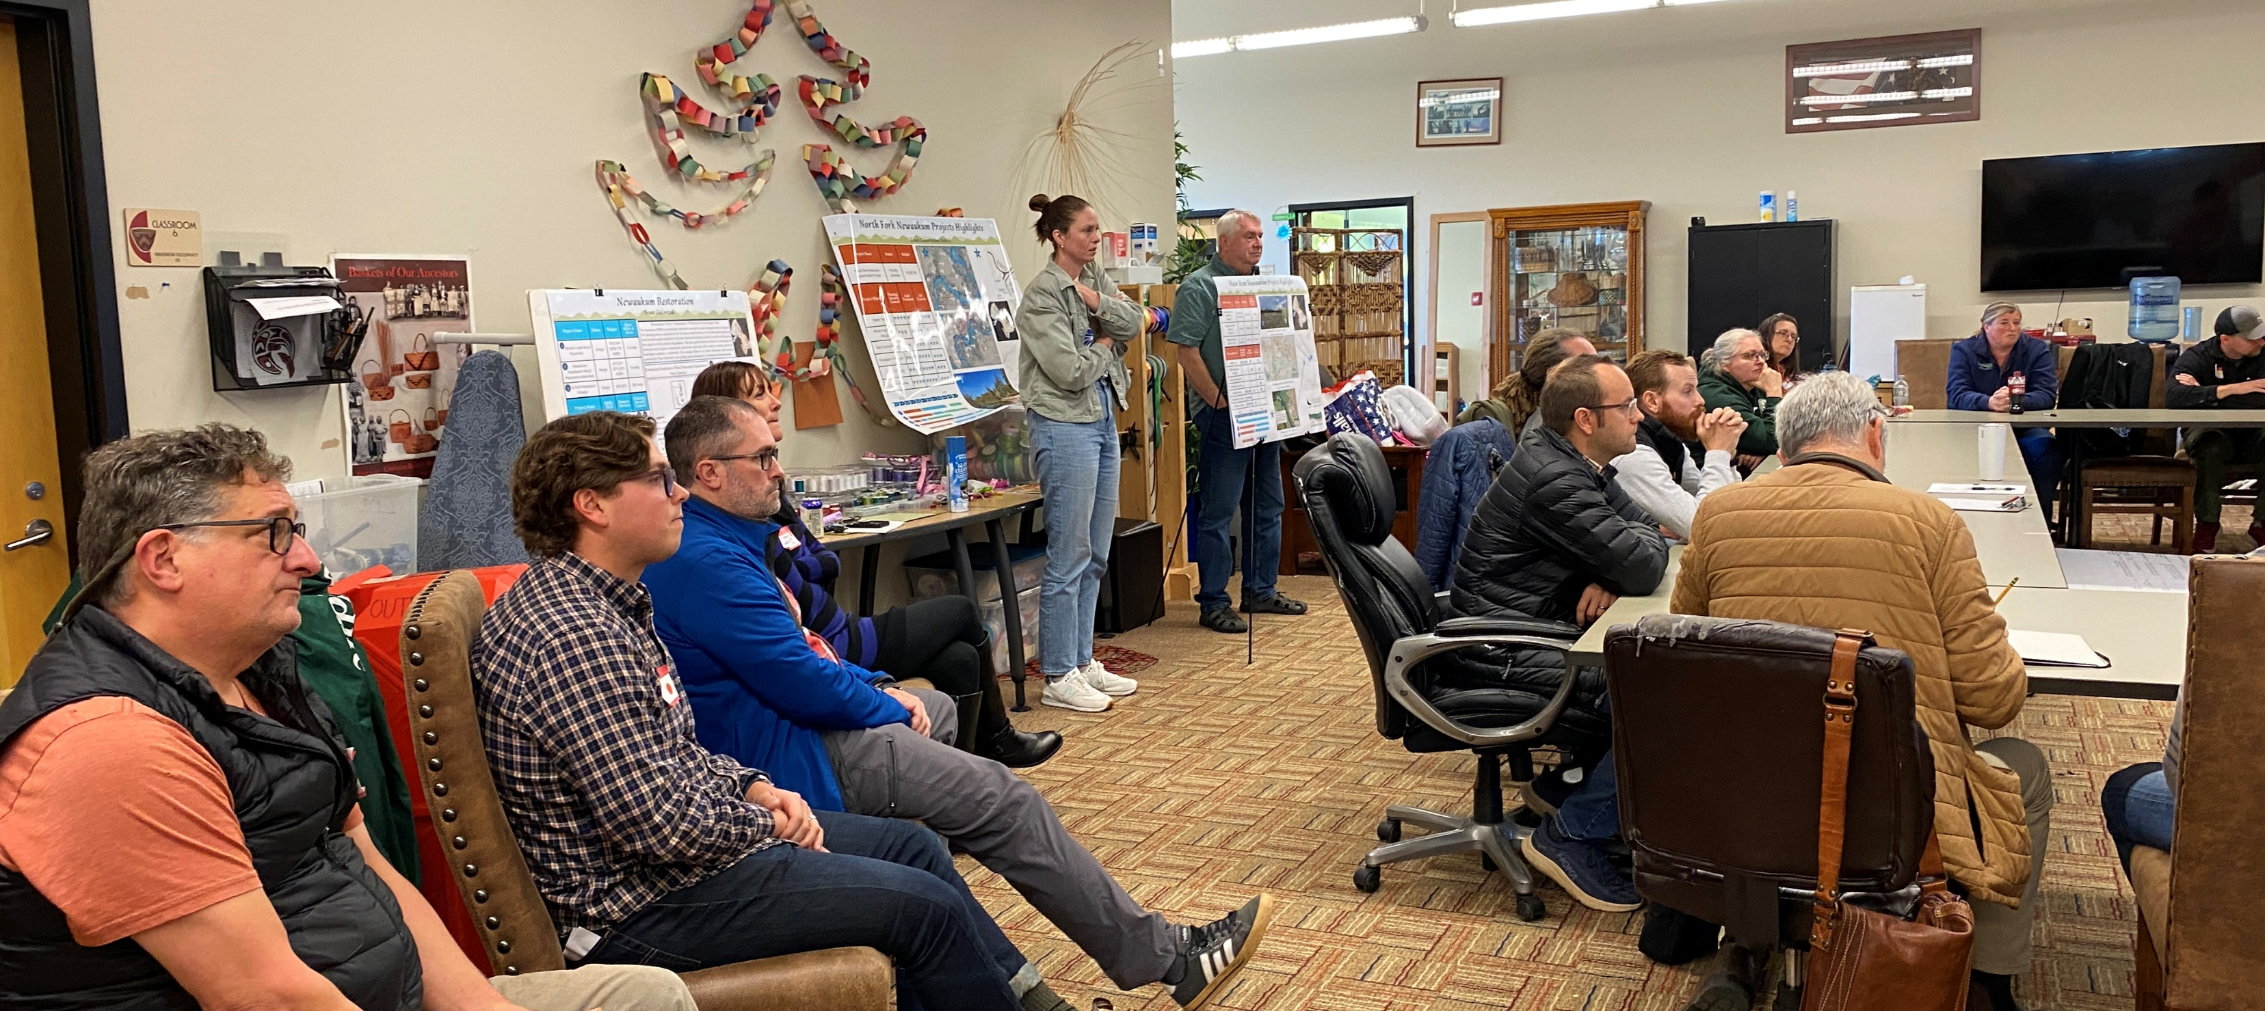

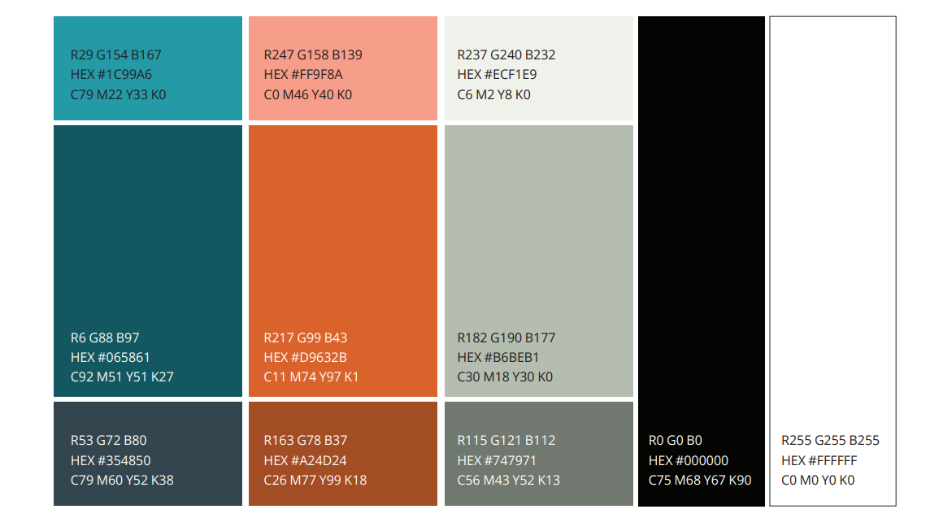


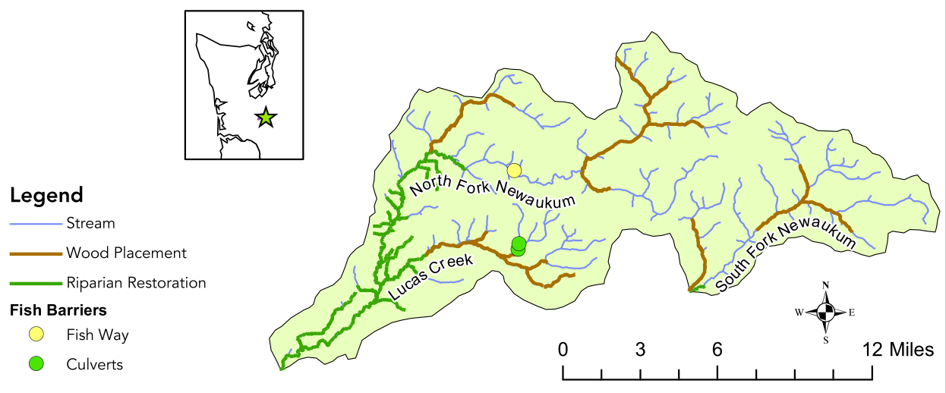
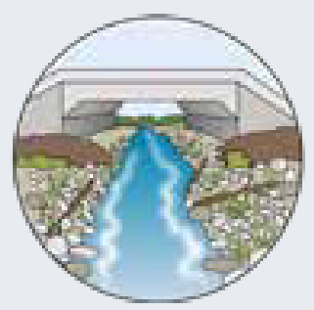
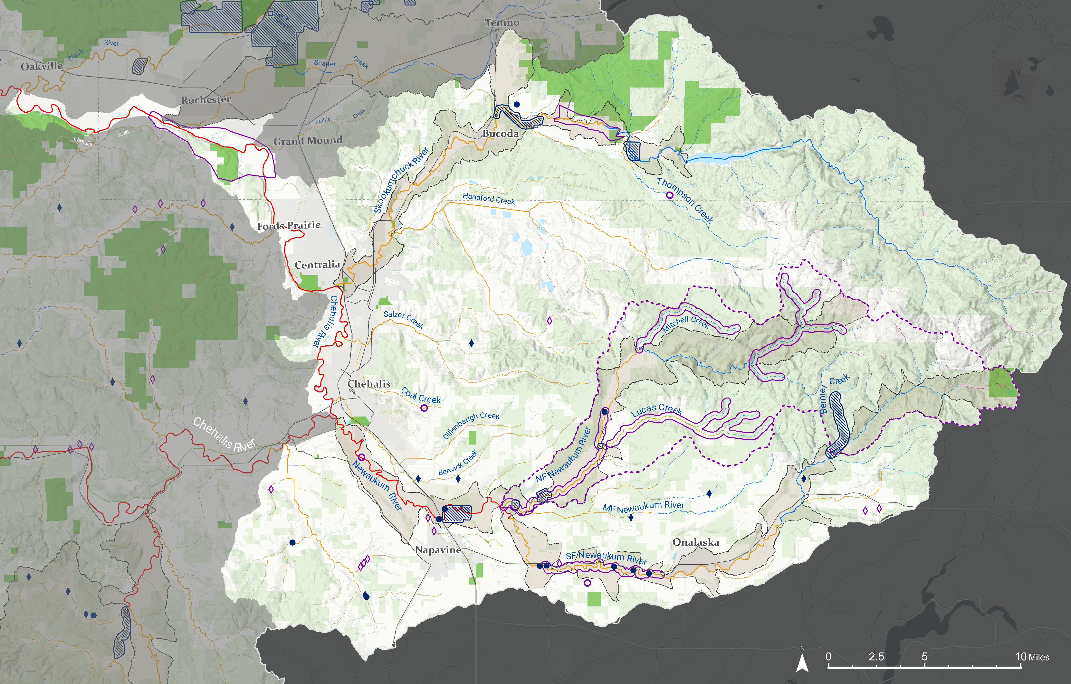
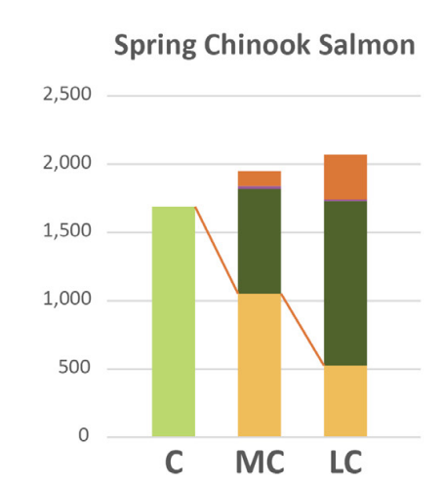
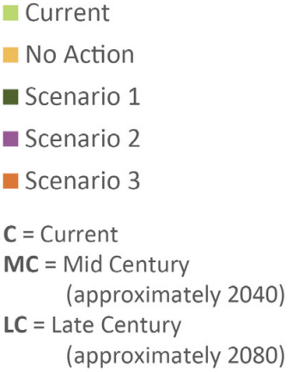




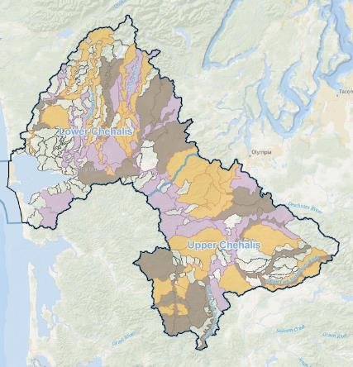
Spring Chinook and Cascades 2026
Project(s) Name | Sponsor(s) | Project Cost | Current Status | Project End | River miles
Chehalis RM 56.5 to 58 | Thurston CD | $150,000 | Site assessment | 2027 | (TBD)
Riverbend Ranch | Thurston CD | $8,184,838 | Planting | 2027 | 2.5
Skookumchuck EAR | WDFW | $4,047,358 | Complete | 2023 | 1.1
Skookumchuck RM 15-17 | Thurston CD | $268,497 | Site assessment | 2027 | (TBD)
Newaukum RM 6.7-7.1 Acquisition | Conservation NW | $245,402 | In Progress | 2026 | (TBD)
Lower Newaukum RM 8-9 Rest. & Acq. | Lewis CD & WFLT | $1,605,000 | Preliminary Design | 2028 | 1.0
NF Newaukum Lawson Reach | Lewis CD | $5,171,997 | Construction | 2030 | 1.3
Newaukum Headwater Wood Placement | Trout Unlimited | $124,800 (ASRP) | Site assessment | 2026 | (TBD)
SF Newaukum RM 14-20 | Lewis CD | $300,000 | Concept Design | 2025 | (TBD)
Bernier Creek RM 1-2 Wood Placement | Trout Unlimited | $200,778 (ASRP) | Final Design | 2027 | 2.1
Skookumchuck and Newaukum Water Lease 2026 | WA Water Trust | $62,507 | In Progress | 2026 | 1 CFS
Restoration & Protection Planning:
Key Questions from 2025 ASRP Planning
Satsop and Newaukum Riparian Connectivity Strategy
Sponsored by Conservation Northwest in 2024
Produced acquisition opportunity on MS Newaukum (now funded!)
Black River, Cascade Mountains, and Willapa Hills Water Use Outreach Strategy
Sponsored by Washington Water Trust in 2024
Multiple “open house” events, resulting in two water forbearance projects (now funded!)
SF Newaukum RM 14-20 Project Initialization
Sponsored by Lewis CD in 2024
Currently in concept design phase for multiple sites
Chehalis Freshwater Mussels Workgroup
Initiated in 2025; facilitated by Xerxes and WDFW
Produced strategy document with prioritized actions for addressing threats →
Coordinated freshwater mussel surveys at ASRP and other in-water-work projects and data entry into freshwater mussel atlas; mussel data available for WDFW habitat biologists
Newaukum Headwater Wood Placement Assessment
Sponsored by Trout Unlimited in 2024
Assess 19 miles of stream and recommend highest 9 miles of priority areas for wood placement
Will bass suppression improve survival of outmigrants?
How can ASRP projects/processes best help freshwater mussels?
Tension between immediate actions and process-based actions- how to align project budgets with programmatic emphasis?
Identified need for “response based” and “anticipated project impact” metrics; beyond “rivermiles restored”
How can we increase the scale of protection projects?
1
2
3
4
5
6
7
8
Newaukum River Workgroup & Headwaters Prioritized Restoration Plan
13.1 miles riparian restoration
Released in summer 2023
Produced by workgroup (a Chehalis Basin Lead Entity subcommittee) consisting of Lewis CD, WDFW, Trout Unlimited, Ecology, Interfluve, Lewis County, Quinault Indian Nation, Coast Salmon Partnership, DNR, USFWS, Weyerhaeuser, and private landowners.
9
12.7 miles instream wood installation
Report and workgroup structure used as template for ASRP “Local Strategy” grants
Initially focused entirely on headwaters, using a combination of desktop models and field assessments to prioritize riparian and wood placement projects
Newaukum workgroup continues to meet- now including all of Newaukum sub-basin.
Currently focused on reducing stream temperature through beaver projects and community engagement
10
3 fish barrier corrections (16.4 miles)
11
Spring Chinook Modeled Response to Restoration Scenarios
Key Findings and Recommendations
11
Key Issue | 2025 Recommendations | 2026 progress and updates
Summer water temperature in larger rivers and streams | Create cold-water refugia and increase shade; total scale TBD but at least 40 miles needed in the lower Newaukum watershed Working with beavers: outreach and restoration | About 1 mile of large wood structures and riparian plantings added to NF Newaukum Beaver were focal topics at Onalaska outreach event Currently no systematic plan to work with beaver
Water-use, water quality, and in-stream flow | Treat at least 48 miles of upper Newaukum watershed with wood and riparian plantings (Lead Entity Strategy) Water use modifications, water right acquisitions, stream restoration. Scale to be determined | Bernier Wood Placement project in design phase- could be implemented next summer Two water forbearance projects in place this summer
Non-Native fish range expansion | Bass Suppression Pilot Project to address uncertainties Community Education | Bass Suppression Pilot Project initiated Juvenile salmon survival study project initiated Currently no formal plan for Community Education
Coastal Chinook Restoration Planning | Gather people for focused discussion on the state of the science around Chinook conservation, and identify next steps and strategies | Chinook Symposium took place in October 2025 in Ocean Shores. Report published in Sep 2026
1
2
4
3
Skookumchuck Dam
8
8
Newaukum River Headwaters Restoration Plan
Too warm
Stream Temperature Suitability for Salmon and Steelhead
Suitable
Optimal
Regional Restoration Plan
Targeted Restoration Development
8
10
Reach Scale Restoration Project
Potential Future
Small Scale Restoration Project
Near Term GSU | ASRP Mileage Goal | Restored - In progress - In development | Percentage [percentage 2025]
Lower Skookumchuck MS | 17 | 3.6 – 0.0 – 2.0 | 33% [33%]
Lower Newaukum MS | 8 | 0.0 – 1.1 – 0.0 | 14% [14%]
SF Newaukum MS | 17 | 0.1 – 2.1 – 2.6 | 28% [28%]
NF Newaukum MS | 15 | 1.3 – 0.0 – 9.0 | 67% [67%]
TOTAL | 57 | 5.0 – 3.2 – 13.6 | 50%
Funded
Potential Future
Fish Passage Barrier Correction
11
6
7
Funded
Chehalis Basin Bass Suppression Project
5
Public Lands
Managed Forestry
9
ASRP Priority Area

