Slide 1
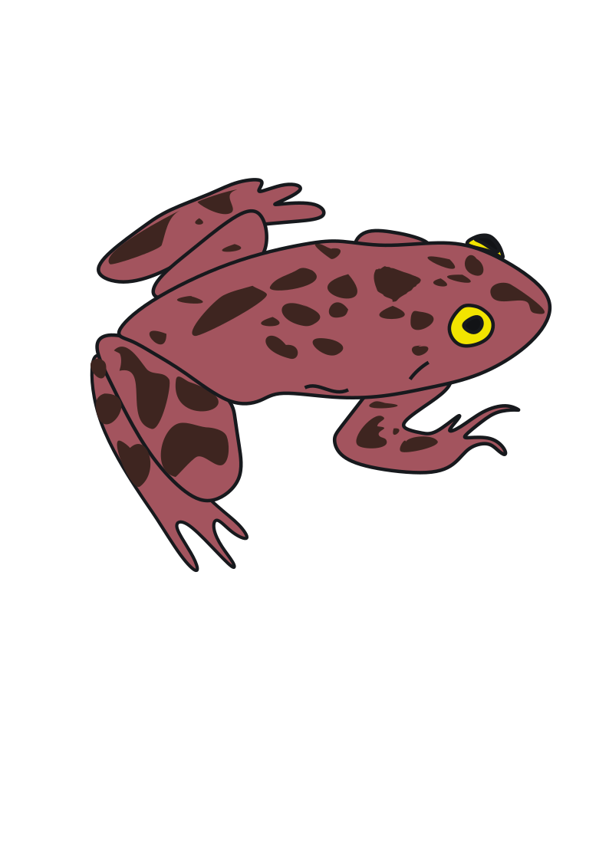
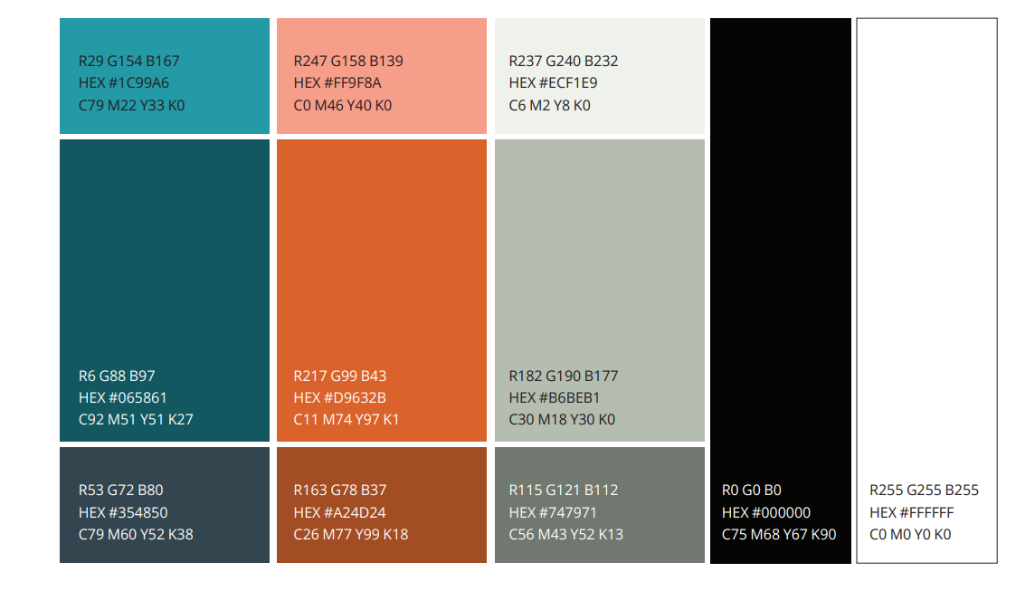
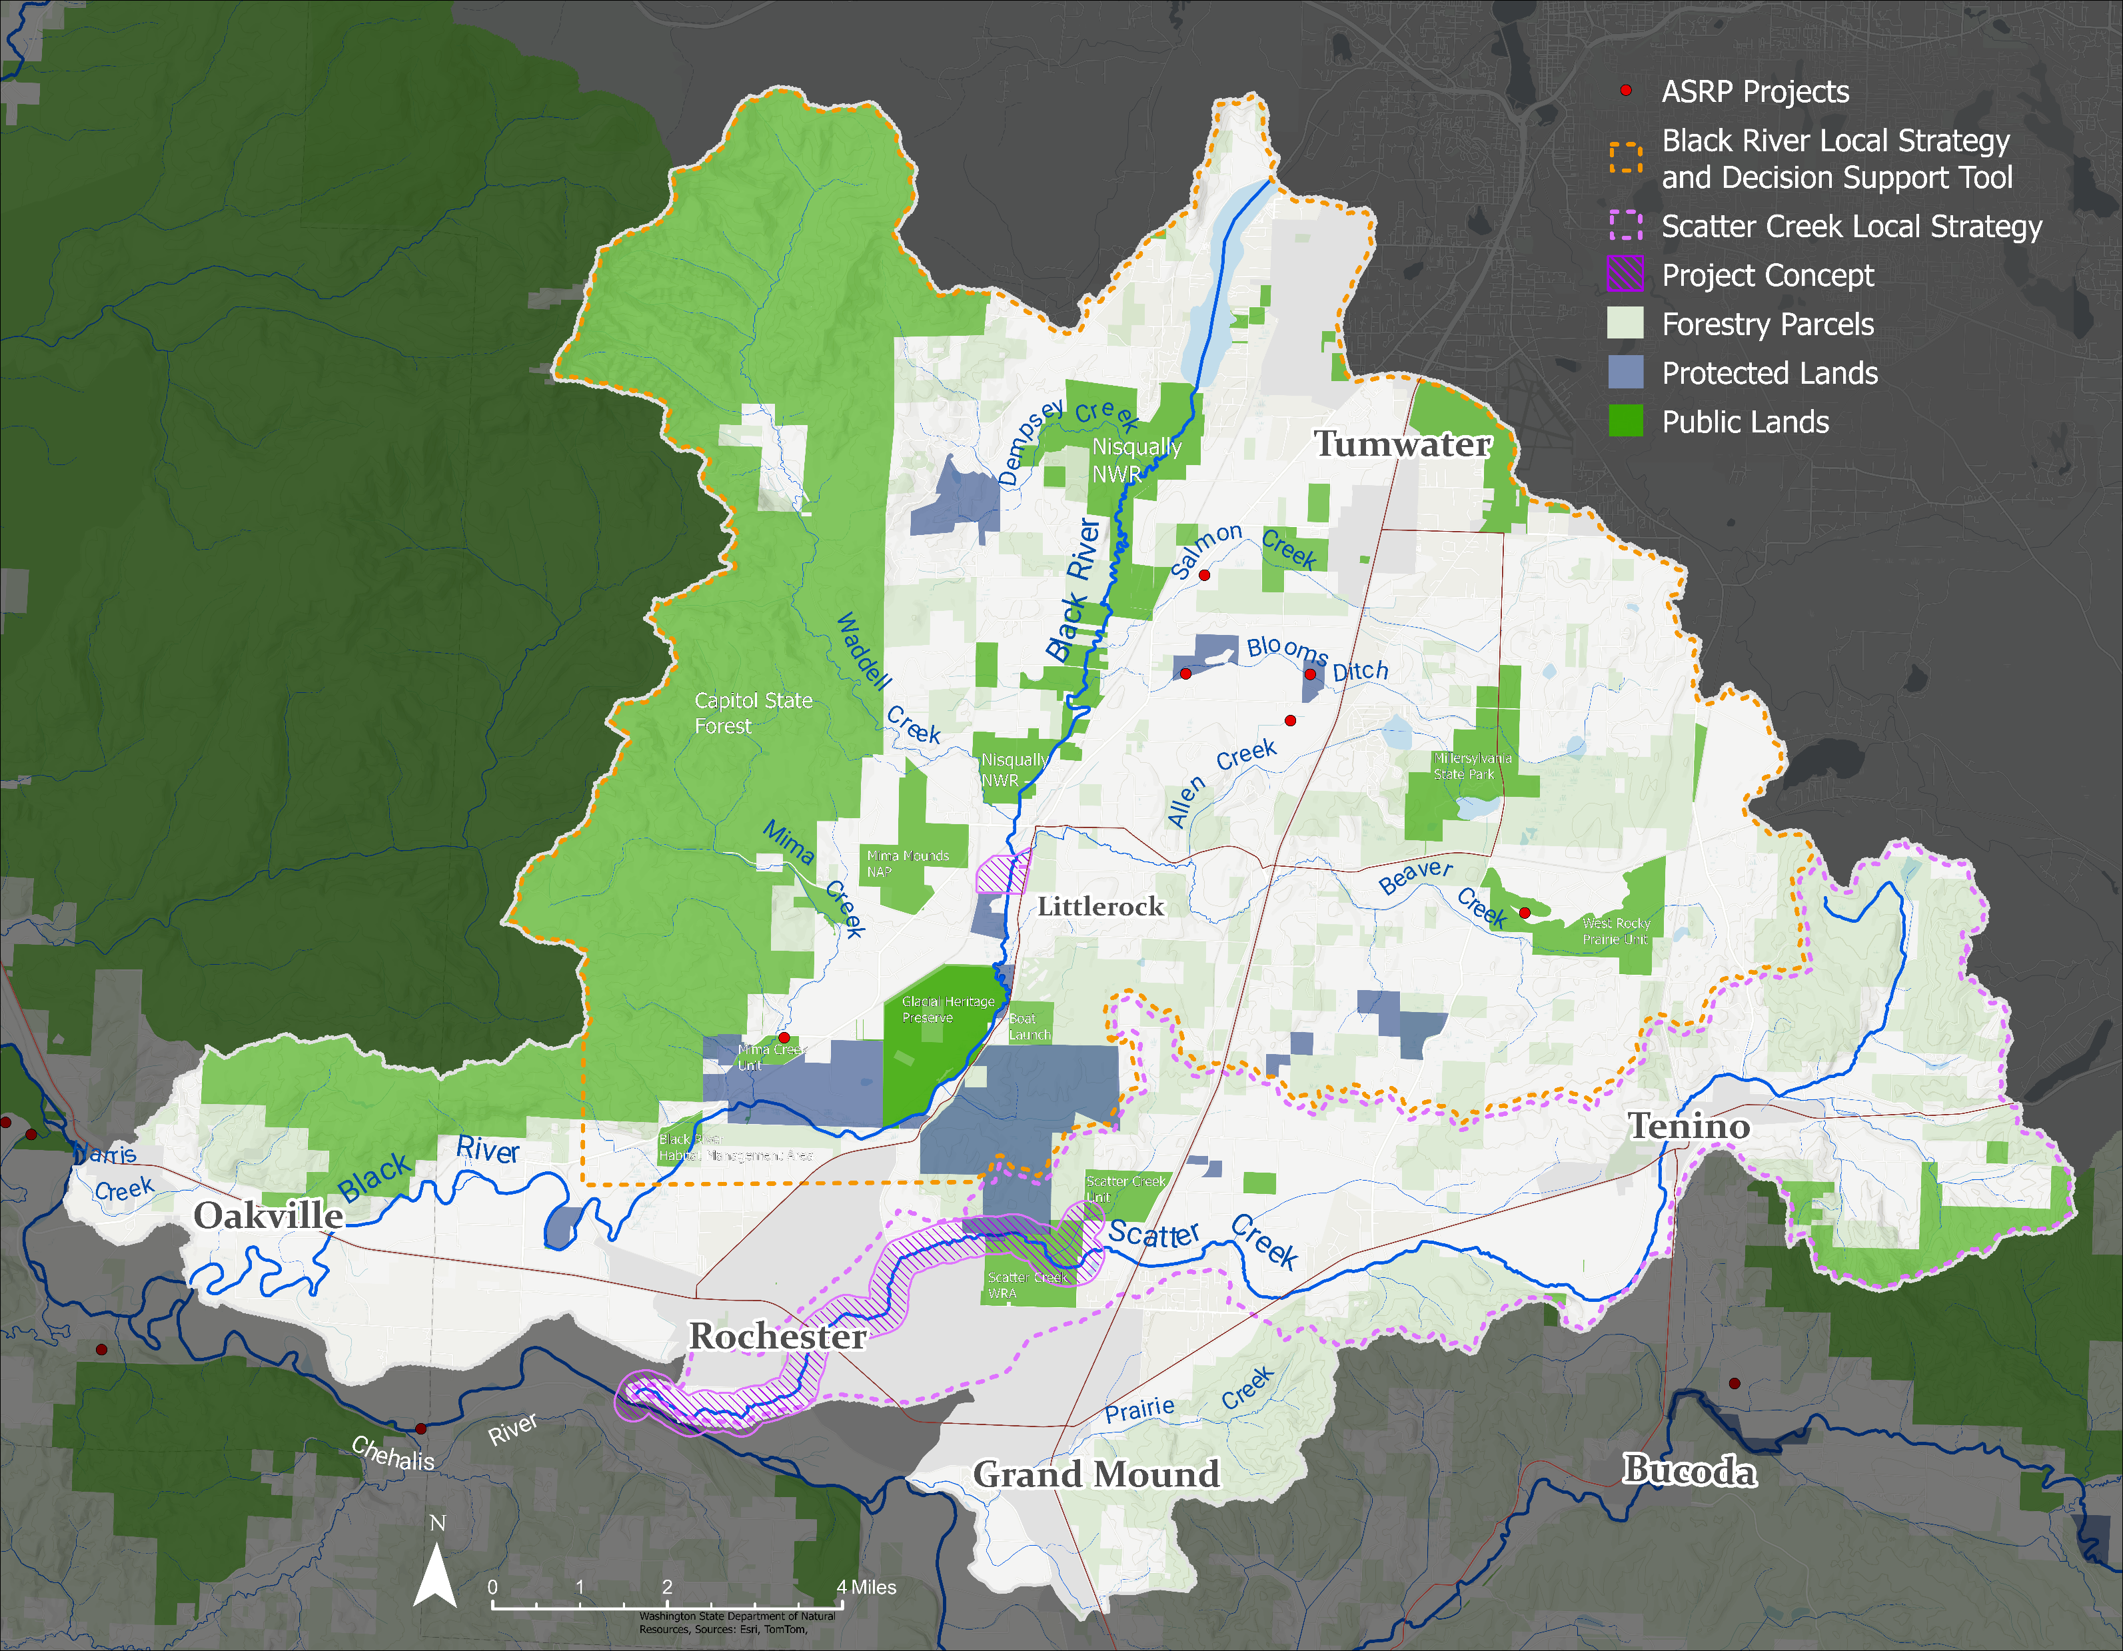
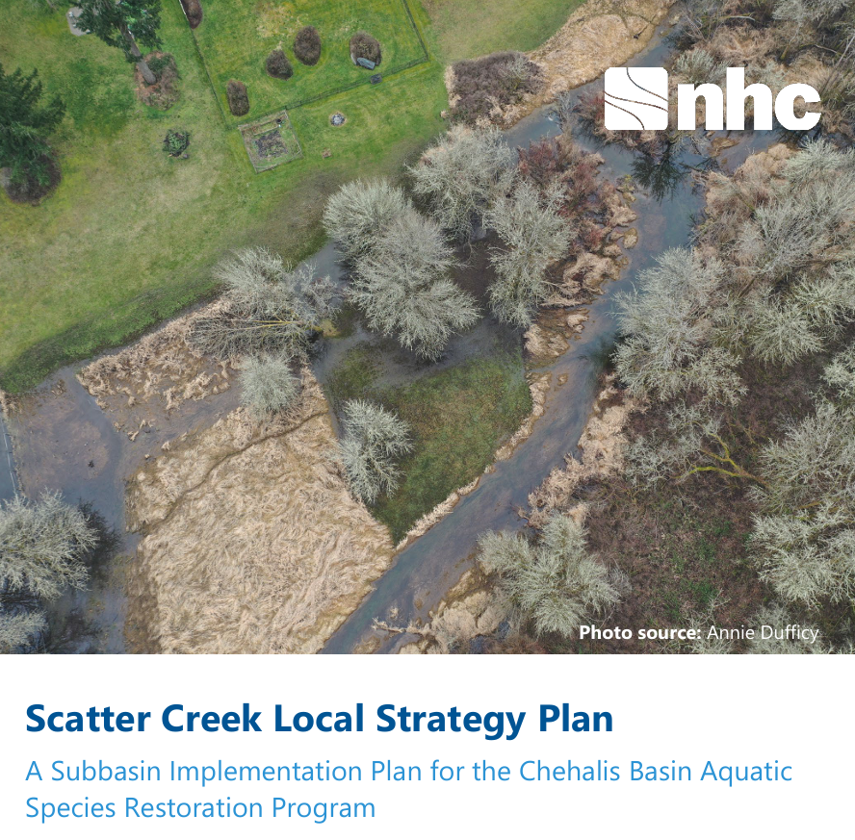

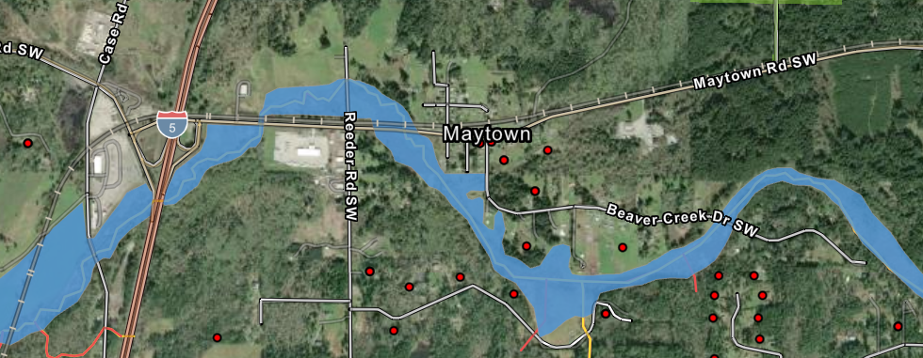
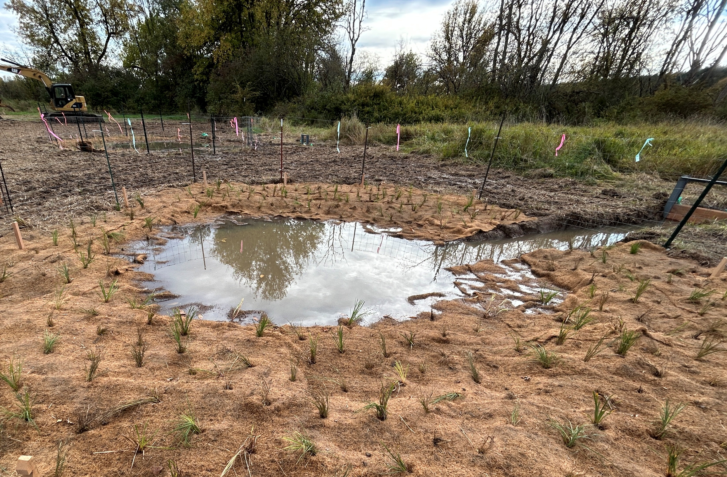
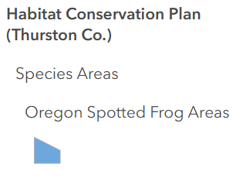
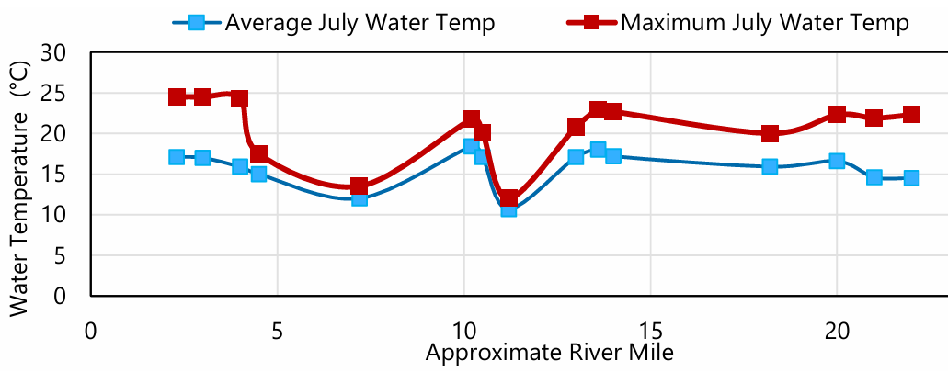

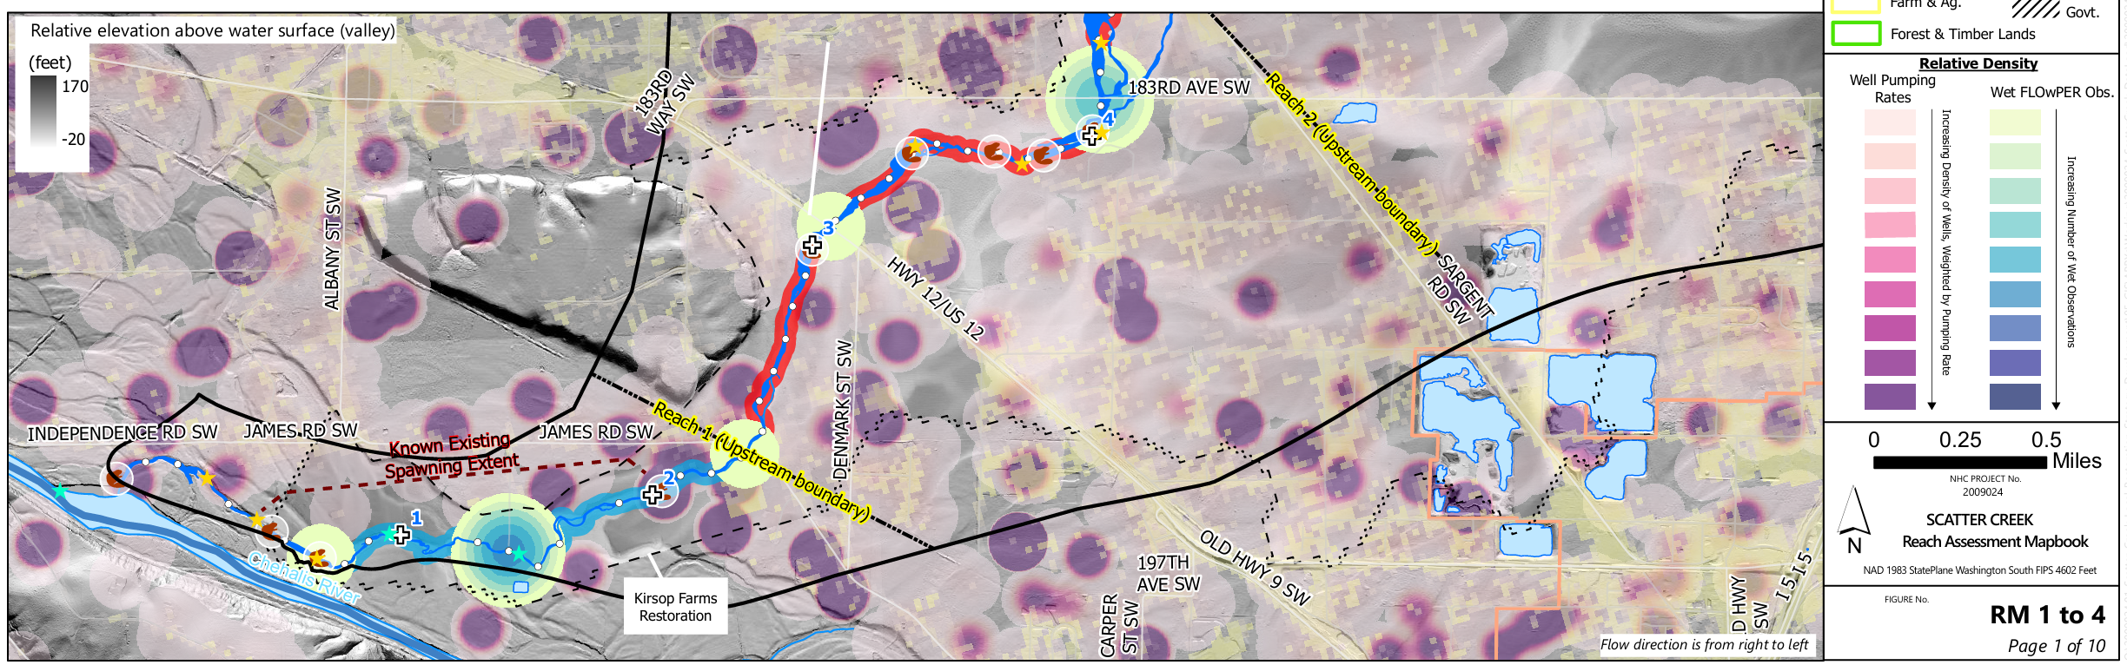
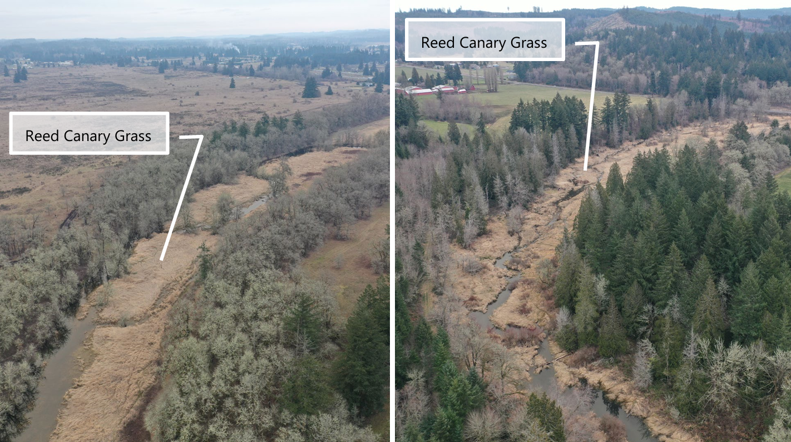
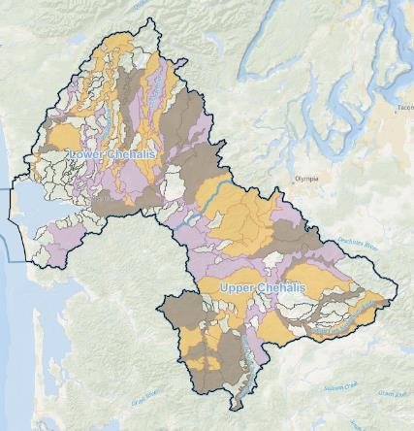
Black River, Oregon Spotted Frog, and Wetlands 2026
Project(s) Name | Sponsor(s) | Project Cost | Current Status | Acres
Black River OSF Mowing | WDFW | $170,000 | Ongoing | N/A
Blooms Ditch OSF-two sites | CLT | $1,283,360 | Site 1: Maintenance Site 2: Easement | 16.5
Allen Creek OSF | WDFW | $19,079 | Included in Mowing Package | .5
Salmon Creek OSF | WDFW | $57,335 | Included in Mowing Package; protection not complete | 1
Mima Creek OSF | WDFW | $220,859 | Included in Mowing Package; Pond constructed 2026 | .25
West Rocky Prairie OSF | WDFW | $159,430 | Included in Mowing Package | 2.5
Scatter Creek RM 0 to 6.6 | TCD | $487,897 | Initial assessment and development | TBD
Beaver Creek Confluence | TCD | $412,893 | Initial assessment and development-awaiting project review/funding | 16.5
Total Cost: $2,240,449 |  |  | Total Acres: 37.25
Key Issue | 2025 Recommendations | 2026 progress
Regional planning & Restoration Goals | Watershed workgroups should consider: Including adaptive management and project effectiveness metrics in restoration strategies Utilizing community science, leveraging outreach opportunities | Black River workgroup in early stages of “SMART goals” discussion Scatter Creek workgroup creating plan fill priority data gaps- could be used to adaptively manage streamflow improvement projects Outreach at multiple venues new for 2026 (Olympia Library, Prairie Appreciation Day, Oregon Trail Days) Landowner interest in pilot projects with effectiveness monitoring, but volunteer data collection waned in 2026
Water-use, water quality, and in-stream flow | Ground water model for Black River to better understand this problem Water use and water rights focused projects- scale to be determined Streamflow-focused projects, such as BDAs and reed canary grass control | Work on Black River Groundwater has commenced, but final product is delayed to Dec 2027 (from Mar 2027) Potential large water-rights project at Cooke Aquaculture, alternative analysis report expected in Dec 2026 Scatter Creek workgroup has found difficulty in quantifying impacts from RCG, beaver, on streamflow Mima Creek Ponds project with water-control structures constructed summer 2026. Project includes hydro modeling and OSF surveys
Resiliency of invasive species control efforts | Continue studies that could result in control methods that require less frequent efforts, e.g. herbicide Some uncertainty on if there is a “process-based” approach relevant to this issue | Analysis of WDFW RCG spraying trials is ongoing- preliminary results suggest multiple years with a combination of treatments will be needed Landowners in Scatter Creek interested in being part of expanded pilot RCG control projects Difficulty in quantifying the true extent of RCG invasion due to insufficient aerial imagery/site data Recent discussions for the potential for the ASRP to fund additional bullfrog control efforts; not all actions possible with ASRP funding
1
2
3
4
5
6
7
8
Restoration & Protection Planning
Black River Local Strategy
Funded in 2025; work started in 2026
Combines CBP facilitation, WDFW groundwater/surface water modeling, and TCD landowner outreach (funded individually)
Data gathering, assessment, and development of a restoration strategy for the Black River watershed.
Assembled a work group consisting of restoration professionals, biologists, and local residents.
Setting watershed-scale goals to prioritize locations and projects based on feasibility, cost effectiveness, and expected benefits to water quality/quantity and aquatic species.
Scatter Creek Local Strategy
Sponsored by Chehalis Basin Partnership in 2023- published June 2025
Produced an analysis of limiting factors and potential restoration actions for each reach (2-4 mile sections) of Scatter Creek
Workgroup consisting of restoration practitioners, county planners, landowners, and biologists continue to meet despite end of grant
Lower reach identified as high priority, leading to TCD Scatter Creek RM 0 to 6.6 project
Current work is focused on prioritizing data gaps to fill
Mima Creek
Two 28’ diameter ponds with level control, 2026 construction
Michelle Tirhi, WDFW
4
2
3
Other Black River Planning Efforts
Black River, Cascade Mountains, and Willapa Hills Water Use Outreach Strategy
Sponsored by Washington Water Trust in 2024
OSF Translocation Feasibility Investigation
Sponsored by WDFW and Thurston CD
Testing Imazapyr for Lower-Cost/Higher-Efficiency Vegetation (RCG) Management
Led by WDFW
8
6
5
Priority GSU | ASRP Acreage Goal | (Acres) Restored - In progress – In development | Percentage [percentage 2025]
Beaver | 19 | 0 – 3.0 – 0 | 16% [16%]
Upper Black MS | 4 | 0 – 0 – 0 | 0% [0%]
Upper Black River Tribs | 4 | 4.4 – 6 – 0 | 260% [260%]
Lower Black River Tribs | 8 | 0.3 – 0 – 0 | 4% [4%]
Lower Black MS | 4 | 0 – 0 – 16.5 | 412% [0%]
Dempsey | 13 | 0 – 0 – 0 | 0% [0%]
Waddell | 4 | 0 – 0 – 0 | 0% [0%]
Scatter Creek | 7 miles | 0 – 0 – 6.6 | 94% [94%]
7
Scatter Creek
Riparian conditions looking upstream at RM 8 (left) and RM 18 (NHC UAV: Feb, 2025)

