Slide 1
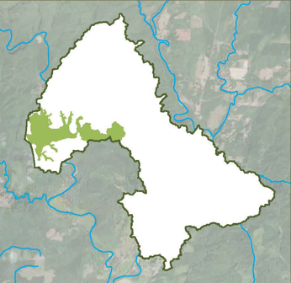
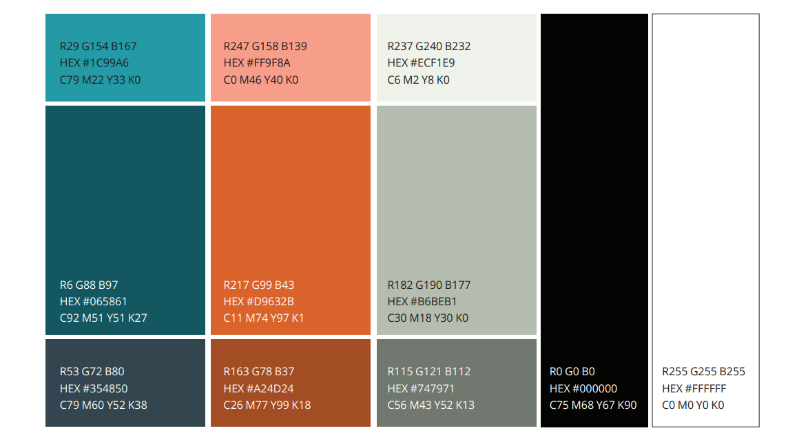
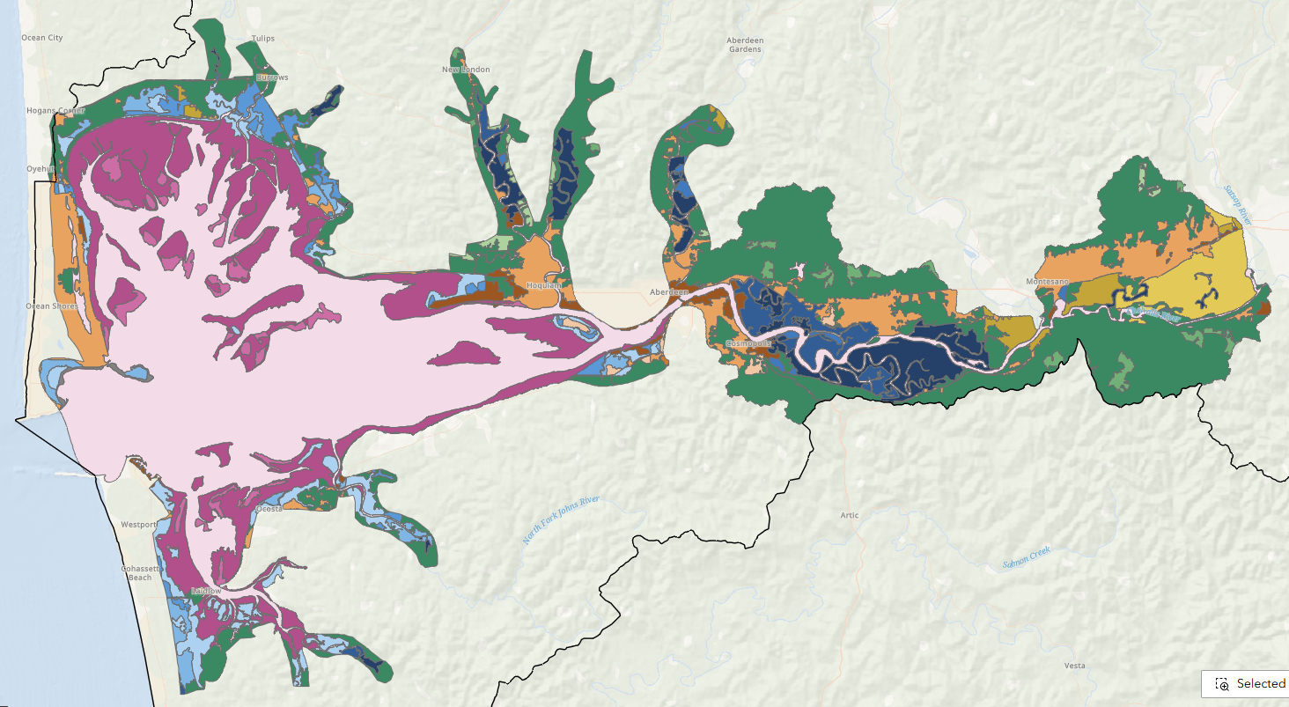

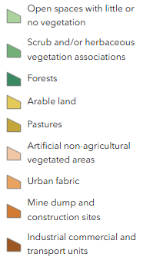

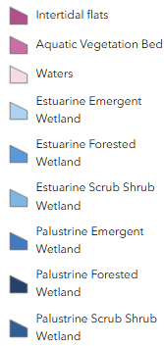
Restoration & Protection Planning
Estuary Overview
Filling Information Gaps
Creosote Piling Inventory Update (DNR)
Eelgrass Mapping & Restoration Proposal (DNR)
Chinook/Steelhead Survival Study (USGS)
Survival: Where in the basin are we losing individuals? Are there estuary-specific sources of mortality that have a bearing on returns?
Residence time in the estuary: how important is estuary habitat quality to the survival of out-migrating Chinook and steelhead?
Pinniped Abundance Assessment
First step toward assessing predation impacts on salmonids
Water Quality Sampling (ECY)
Habitat Mapping (Anchor)
Opportunity to provide feedback on ASRP Webmap, refine this tool
Chehalis RM 13-20 Planning/Assessment
Sponsored by Grays Harbor CD
Identifies project opportunities to initiate long lead time actions in priority GSUs in forested tidal surge plain
Protection Planning
Sponsored by Forterra NW
Identifies habitat protection priorities and opportunities in the Estuary Ecoregion
Key 2025 Takeaways
& Next Steps
= acoustic receivers
In-progress planning and mapping efforts
Identified next step: coalesce around priority planning / project developments to continue moving forward → Land Protection LS
  Next potential large planning effort: Aberdeen Shoreline Softening Local Strategy → GHCD to lead?
“Low-hanging fruit” project opportunities will likely still be challenging
West Fork Hoquiam Dam Removal
ECY Streamflow Restoration Grant: $3,599,892
City of Hoquiam
Coastal Resilience and Other Projects (CCA $):
Coastal erosion & SLR
WSDOT, ECY, WDFW, Flood Authority, EMD
Transportation Infrastructure + Habitat
Chehalis RM 14.5-17.5
Protection/acquisition, reach-scale restoration, landowner outreach
High priority riparian planting above surge plain (sea level rise preparation)
Potential structure elevation(s) / relocation(s)
North Shore Levee
Flood protection, Hoquiam & Aberdeen
Funded at $17mil
Elk River RM 10 Protection
Protect rare salt marsh and surge plain forest
Increase footprint; direct adjacency to the DNR NAP
Development threat extinguished
Restore shrub and forest tidal wetlands that are currently rare and expand upstream to accommodate sea level rise
Cosmo Specialty Fiber Plant
ECY Toxic Removal
In progress, not ASRP
Chehalis RM 13-67 Brazilian Elodea Removal (GHNWB)
Remove Brazilian Elodea
Peels Slough & Trib. + Alder Grove
Protect and restore 87 acres of floodplain
Adjacent to DNR land; increases footprint
Allows floodplain and wetland connectivity
Extinguishes development threat
ASRP Implementation Projects Funded
Project(s) Name & Symbol | Sponsor(s) | Project Cost | Current Status | Project End | River miles/ Acres
Camp Creek at Schafer Boom Road | CBFTF | $877,800 | Complete | June 2026 | 5.65 mi access
Surge Plain Protection: Peels Slough & Tributary + Alder Grove | Forterra | $638,000 | In Progress | April 2027 | 96-102 acres
Elk River RM 10 Protection | Forterra | $452,400 | In Progress | March 2027 | 40 acres
Protection Local Strategy Planning | Forterra | $139,668 | In Progress | Aug 2027 | In Planning
Chehalis RM 14.5-17.5 | GHCD | $250,352 | Concept | June 2027 | 2-7 mi
Oyhut Proposed Acquisition | Forterra | $699,500 | Non-ASRP | 2026 | 18.7 acres
Elodea Removal RM 13-67 | GHNWB | $1,331,700 | In Progress | 2029 | 54 mi
Priority Knowledge:
tide gate barriers
eulachon population dynamics and habitat use
smooth cordgrass distribution
salmonid prey abundance in varying habitat types
water quality: seasonality of concerns in shallow and shoreline habitats
identify potential cold-water refugia
project effectiveness monitoring for large wood placements

