Slide 1
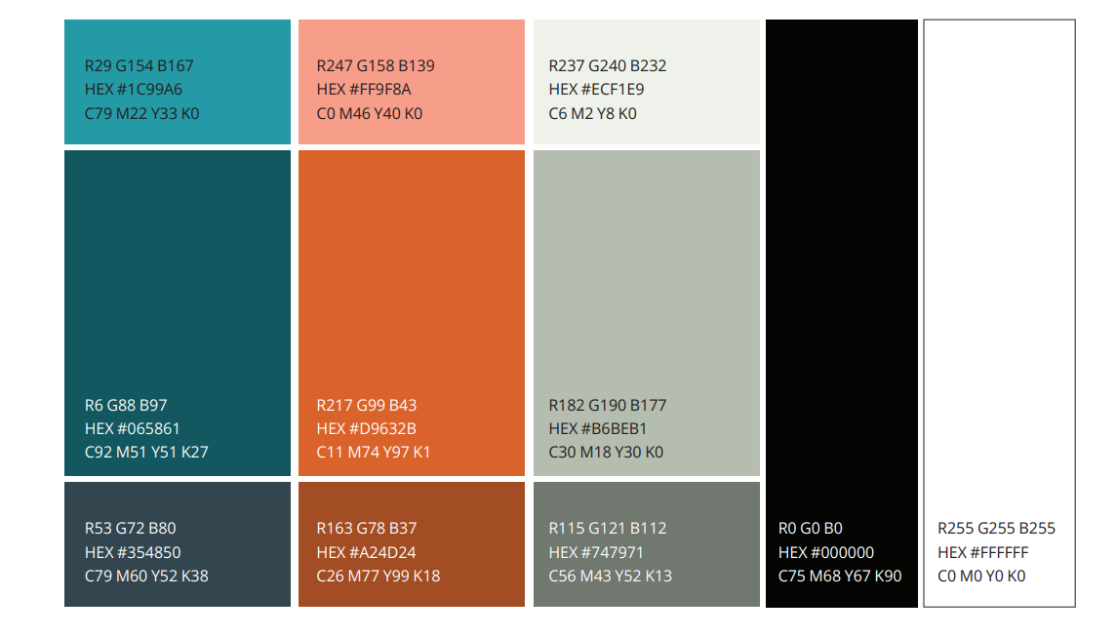
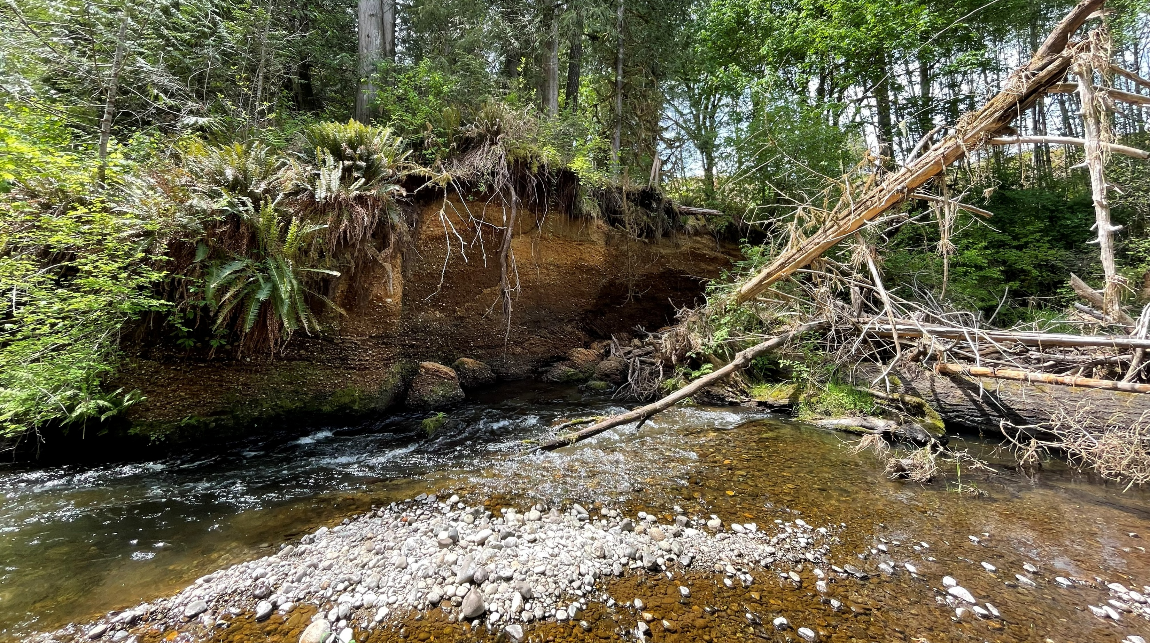
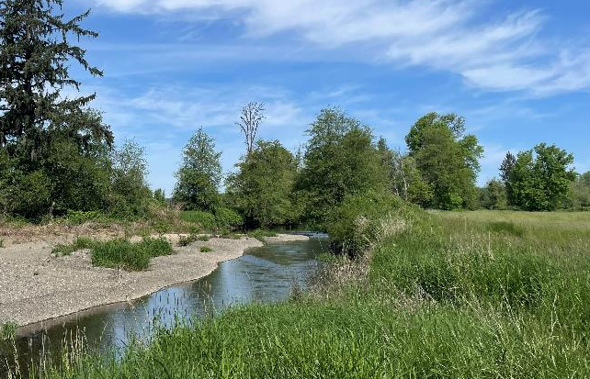
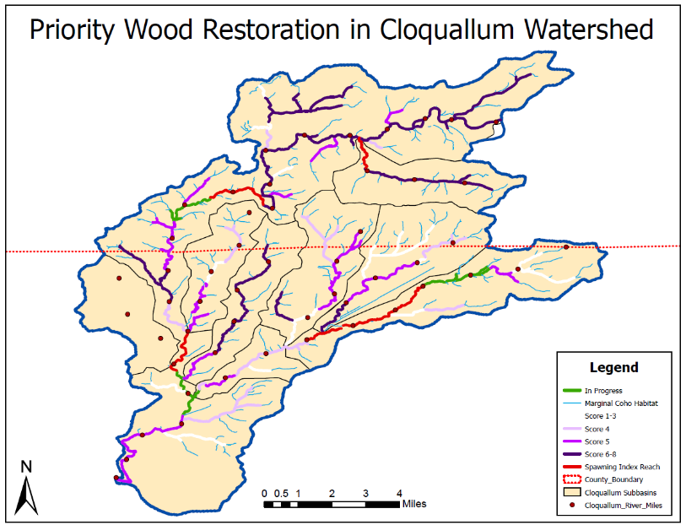
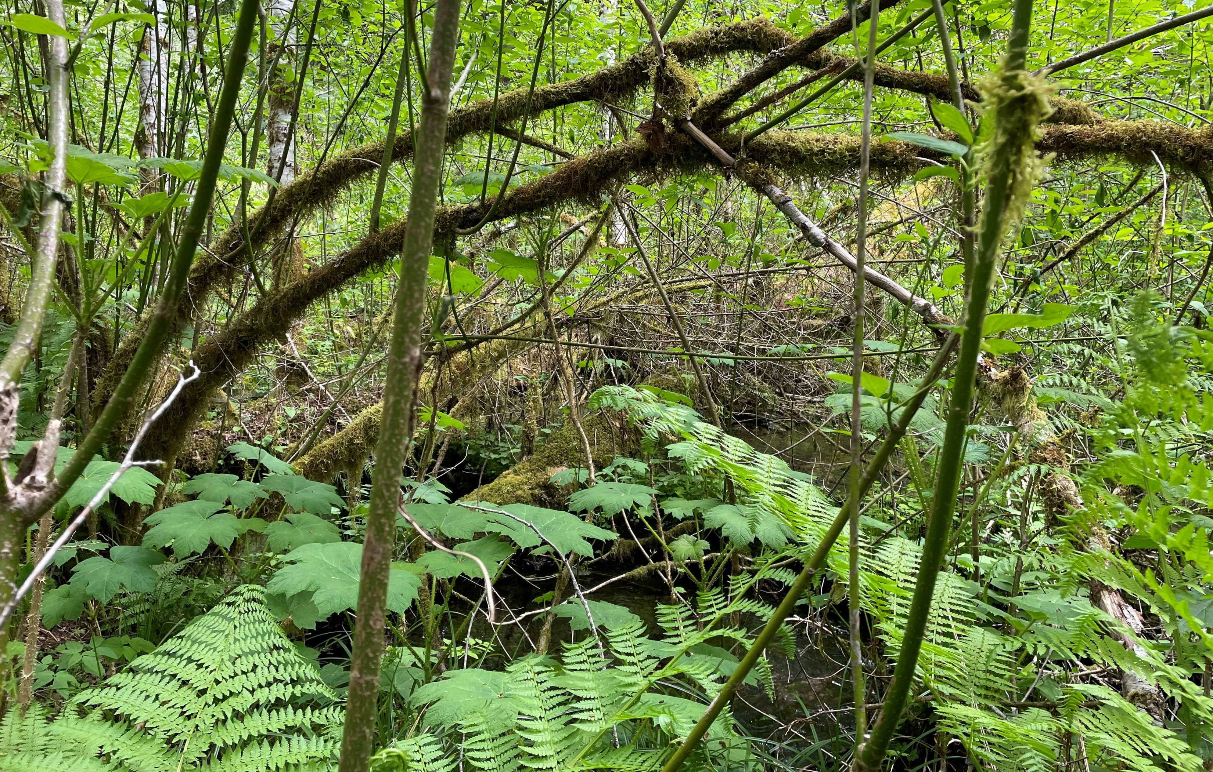

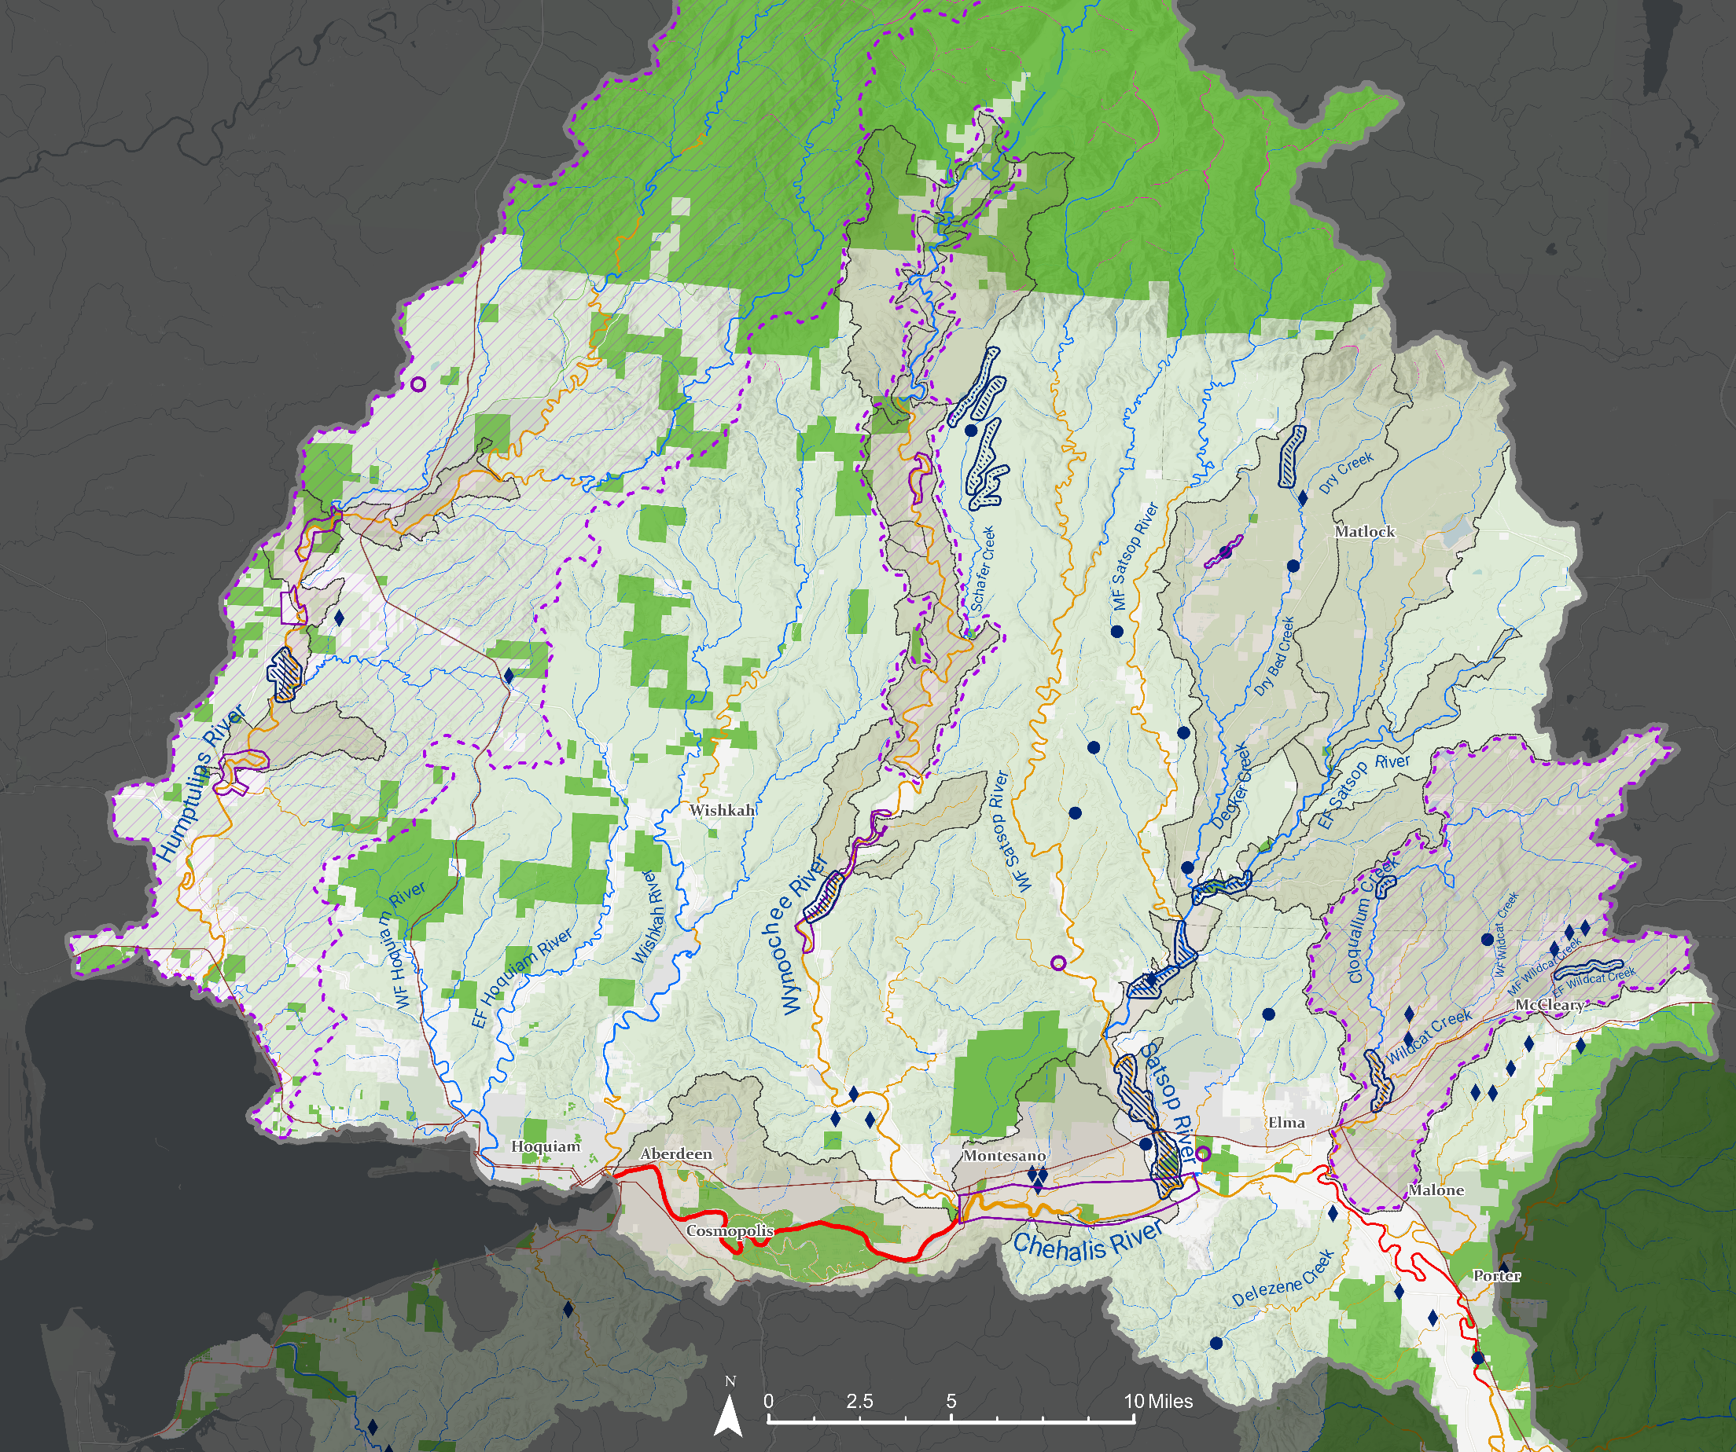
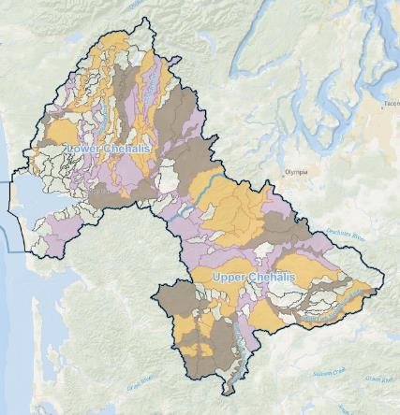
Olympic Mountains and Cloquallum 2026
Key Findings and Recommendations
Key Issue | 2025 guidance | 2026 progress/updates
Aligning sponsor-led watershed-scale restoration and protection strategies with ASRP Priorities | Technical experts weigh in on watershed-scale planning efforts Project sponsors coordinate planning and outreach efforts with people who work on the ground in the field | Cloquallum workgroup has received additional funding, and next steps will include collection of field data following ASRP SC recommendations Programmatic uncertainty remains regarding including technical experts in watershed planning efforts
Minimizing short-term impacts from restoration implementation on key species | Coordinate with fish and habitat bios early and often Emphasize protection and “passive” restoration actions Utilize low-cost monitoring techniques and coordinate with technical experts to interpret habitat assessment data | 2026 TAG discussions focused on upper watershed habitats and coastal tailed frog. TAG is hesitant to recommend large-scale projects for tailed frog until more is understood. ASRP helped coordinate freshwater mussel surveys around 7 projects sites within the cluster area, to help avoid impacts ASRP started a new process to request field biologist comments earlier in the project application cycle
Longevity and effectiveness of process-based restoration techniques | Scientist-sponsor-landowner coordination to monitor and test physical/biological responses to treatments; this could help refine techniques in a more dynamic way and add knowledge | Construction funding for Dry Bed Creek RM 9-11 was delayed due to uncertainties around project effectiveness; potential to fund effectiveness monitoring study which could inform similar projects ASRP in early phases “Wood Placement Workgroup” planning for metric tracking and effectiveness monitoring recommendations
Understanding habitat function through monitoring proxy species such as macroinvertebrates | Coordinate among study leads and technical experts to provide guidance to inform monitoring and adaptive management Provide monitoring results to project sponsors | Grays Harbor Stream Team has started a Citizen Science Macroinvertebrate Monitoring Program No new guidance has been shared with ASRP project sponsors in 2026 Macroinvertebrate data and indices compiled by ECY to inform planning
Project Development Work
Cloquallum Local Strategy (PWR)
Humptulips River Restoration Plan • Sponsored by QIN in 2023
Released summer 2023
Targets coho restoration and funded by federal disaster relief funding
Produced by workgroup consisting of QIN, NSD, GHCD, WDFW, CSP, DNR, FWS, Rayonier, CBLE, and TU.
Used riparian data, floodplain connectivity potential, fish use, and land use to prioritize reaches for restoration
Created sub basin specific recommendations, including the ASRP near-term Mid Humptulips
Satsop and Newaukum Riparian Connectivity Strategy • Sponsored by CNW in 2024
Identifies opportunities to connect riparian habitat (existing and restored) in Newaukum and Satsop River Basins
Wynoochee RM 12.5-18 & RM 34-36 • Sponsored by GHCD in 2024
Data collection, alternatives analysis, and concept design for reach scale projects in on MS Wynoochee. Includes expanding EAR project area. Upper region identified from previous PD.
Middle Wynoochee Restoration Planning • Proposed by GHCD in 2025
Re-evaluation of the Middle Wynoochee GSU- previous assessments identified shortcomings of desktop-based methodology. Seeks to identify best 10 miles of habitat restoration opportunities based on geospatial assessments, field reconnaissance, and landowner engagement
Middle Humptulips Local Strategy • Sponsored by GHCD and TU in 2022
Project development through landowner engagement and developing restoration ideas/options. Coordinating with QIN on Humptulips River Restoration Plan
Olympic Timber Landowner Report • Sponsored by GHCD in 2020
Desktop modeling which prioritized headwater streams for restoration based on floodplain connectivity potential and created initial concepts for top ranked reaches
Plan Development still ongoing since 2024
Workgroup consisting of: CBC-fSH, CSP, GHCD, MCD, WDFW, QIN, USFWS, DNR, GHC, landowners
Actions: instream wood restoration, riparian restoration, barrier correction, and implementation of climate-adaptive strategies to address low streamflow
Model-based prioritization w/ feasibility integrated
Active Projects: Grays Harbor CD and Mason CD have an ASRP-funded grant to Assess 55 miles of river/streams!
Planned projects: Design for South Union Road Barriers – a priority “cluster”
Targets treatment of impaired watershed processes over 20% of anadromy
Project(s) Name | Sponsor | Project Cost | Current Status | Project End | River miles
Experimental BDAs | DFW & WFC | $383,959 | Complete | 2024 | 2.6
MF Wildcat Creek Passage | CBFTF | $1,272,848 | Complete | 2024 | 4.1
Cloquallum Knotweed Control | GHCD | $675,276 | Ongoing | 2029 | NA
Cloquallum 3.8-6.0 | GHCD | $4,978,151 | Construction | 2029 | 2.2
Cloquallum RM 11 | MCD | $188,213 | Concept/Design | 2027 | 1.0
EF Wildcat RM 4-6 | GHCD | $599,965 | Construction | 2027 | 2.0
Lower Satsop RM 0-2 | GHCD | $9,160,466 | Planting | 2027 | 2.0
Satsop RM 2.5-5.0 | GHCD | $5,474,083 | Complete | 2028 | 2.5
Lower Satsop Tribs/ Riparian | CNW | $115,677 | Planting | TBD | 0.2
EF Satsop EAR | WDFW | $7,392,270 | Complete | 2023 | 3.2
EF Satsop Schafer St Park | MCD | $511,350 | Prelim Design | TBD | 2.1
Decker Creek RM 12.5-14/RM 13 | MCD | $230,452 | Concept/Design | TBD/ 2026 | 1.5
Dry Creek at Beeville Road | TU | $349,750 | Design | TBD | 7.0
Dry Bed Creek RM 9-11 | TU | $183,835 | Design | TBD | 2.0
Dry Bed Creek at Deckerville | MCD | $117,016 | Design | 2026 | 0.1
Decker Creek RM 1-1.5 | MCD | $244,746 | Design | TBD | 0.5
Still Creek | GHCD | $135,000 | Prelim Design | TBD | 3.0
Wynoochee EAR | WDFW | $6,683,415 | Complete | 2023 | 1.3
Wynoochee RM 12.5-18 | GHCD | $60,000 | Concept | TBD | 4.2
Wynoochee RM 34-36 | GHCD | $88,220 | Alt Analysis | TBD | 2.0
Schafer Creek Headwaters 8-9 | GHCD & TU | $250,000 | Complete | 2024 | 1.0
Schafer Creek – WCRRI | GHCD | $2,103,214 | Construction | 2029 | 9.5
Sediment Wedging | WDFW | $1,861,786 | Complete | 2024 | 0.5
Humptulips RM 9-12 & 18-19 | GHCD | $152,698 | Concept | TBD | 4.0
Humptulips RM 15-17 | GHCD | $446,311 | Planting | TBD | 2.0
Humptulips RM 20-22.7 | GHCD & TU | $166,936 | Concept | TBD | 2.7
Stevens Creek Tributary | QIN | CCA | Prelim Design | TBD | 0.6
Experimental Off-channel | WDFW | $232,000 | Prelim Design | TBD | NA
Total: $44,057,637 |  |  | Total: 63.8
1
2
3
4
5
Too warm
Stream Temperature Suitability for Salmon and Steelhead
Near Term GSU | ASRP Mileage Goal | Restored - In progress - In development | Percentage [percentage 2024]
Cloquallum | 10 | 4.1 – 2.0 – 3.2 | 93% | [83%]
Lower Satsop MS | 3 | 4.5 – 0.0 – 0.2 | 157% | [157%]
Lower EF Satsop MS | 6 | 3.2 – 0.0 – 2.1 | 88% | [88%]
Decker | 8 | 0.0 – 0.0 – 4.1 | 51% | [51%]
Bingham | 7 | 0.0 – 0.0 – 0.0 | 0% | [0%]
Dry Run | 3 | 0.0 – 0.0 – 0.0 | 0% | [0%]
Upper EF Satsop MS | 6 | 0.0 – 0.0 – 0.0 | 0% | [0%]
Middle Wynoochee MS | 15 | 0.0 – 0.0 – 2.0 | 13% | [0%]
Middle Wynoochee Tribs | 4 | 0.0 – 0.0 – 0.0 | 0% | [0%]
Middle Humptulips MS | 11 | 0.0 – 2.0 – 7.3 | 85% | [85%]
6
Suitable
7
Optimal
Potential Future
Small Scale Restoration Project
8
Funded
9
Potential Future
Fish Passage Barrier Correction
Funded
10
Regional Restoration Plan
11
Targeted Restoration Development
12
Reach Scale Restoration Project
27
23
21
14
13
Public Lands
22
Managed Forestry
20
13
14
ASRP Priority Area
26
12
15
15
24
16
25
17
24
1
18
16
19
19
10
5
2
20
18
17
11
6
21
1
22
8
4
23
9
24
7
25
26
23
27
28
28

