Slide 1
Interim Findings
Delta Architecture

Slide 2
Purpose
Compile Data Layers to develop a basis for:
Measuring
Tracking
Evaluating
River delta restoration

Slide 3
Approach
Deltas change continuously
Tidal flooding and river flows drive landscape structure
GIS: define landscape structure by tidal process domain
GIS: begin identification of river process drivers
GIS: define project footprint (tracking) in whole delta landscape
Describe current and future at delta scale, with rollup to Puget Sound – reference Simenstad et al’s past.
Use as platform to define evaluation, and 2nd generation tracking

Slide 4
GIS Layers
Delta boundary (Simenstad et al. 2011)
Digital elevation models (USGS et al.) & tidal datum (NOAA)
  Estimated potential tidal inundation regime
  Estimated area of current tidal inundation
River distributary channels (NEW)
Current wetland mapping (Simenstad et al. 2011)
Landcover (C-CAP based on LANDSAT 30m)

Slide 5
DEMs & Tides
Sources of error
  LIDAR measurements
    Inconsistent coverage, best in NKS, SKG, STL, NSQ, SKO
    2011 surveys higher quality ~8 points per cell, but validation surveys may underestimate error in complex landforms
    Stitching bathymetry and multiple LIDAR layers labor intensive.
  Griding Algorithms
    Less of an issue with modern LIDAR due to point density
    Aggravated by irregular topography
    Old LIDAR has extrapolation with <1 pt per cell

Slide 6
DEMs & Tides
Sources of error
  Tidal datum estimates
    Based on relatively precise measurements
    Nearby tidal datum in all but STL
Weakness is in older DEMs and truely representative validation; new DEMs have potential for very high (+/- 2cm) accuracy, but not field tested.

Slide 7
GIS Layers
Delta boundary (Simenstad et al. 2011)
Digital elevation models (USGS et al.) & tidal datum (NOAA)
  Estimated potential tidal inundation regime
  Estimated area of current tidal inundation
River distributary channels (NEW)
Current wetland mapping (Simenstad et al. 2011)
Landcover (C-CAP based on LANDSAT 30m)

Slide 8
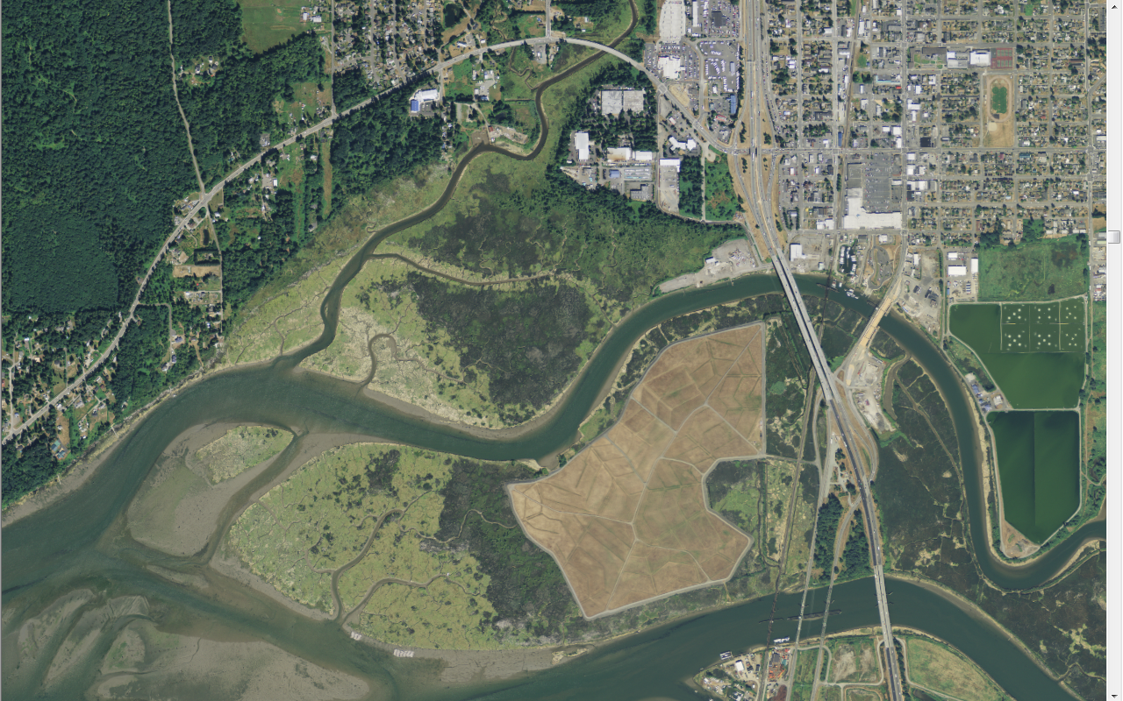
DEMs & Tides

Slide 9
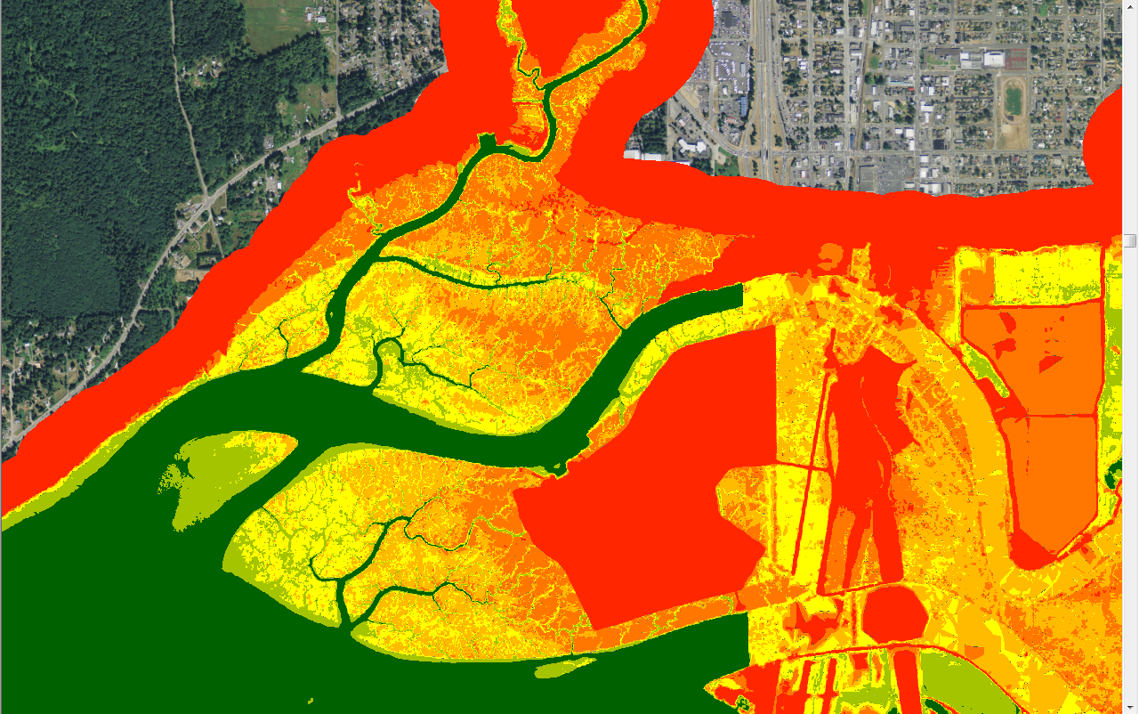
DEMs & Tides
MHHW-XHW
MHW-MHHW
MT-MHW
SUPRA-TIDAL

Slide 10
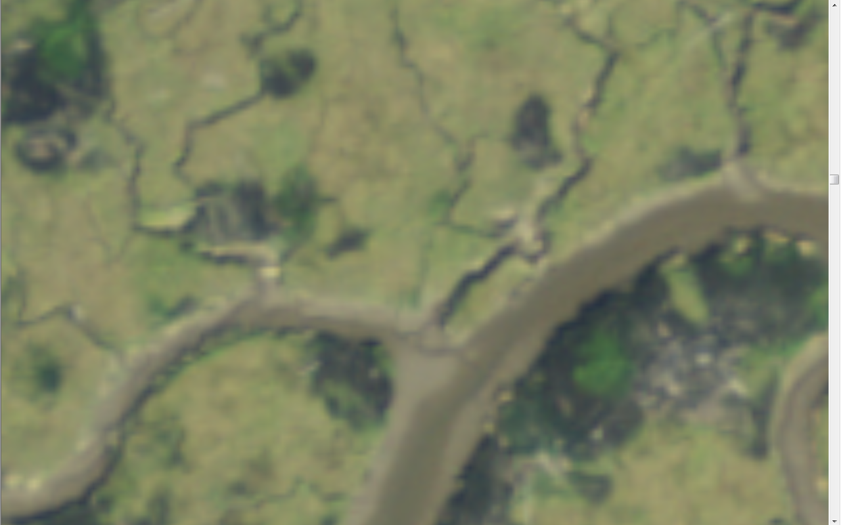
DEMs & Tides

Slide 11
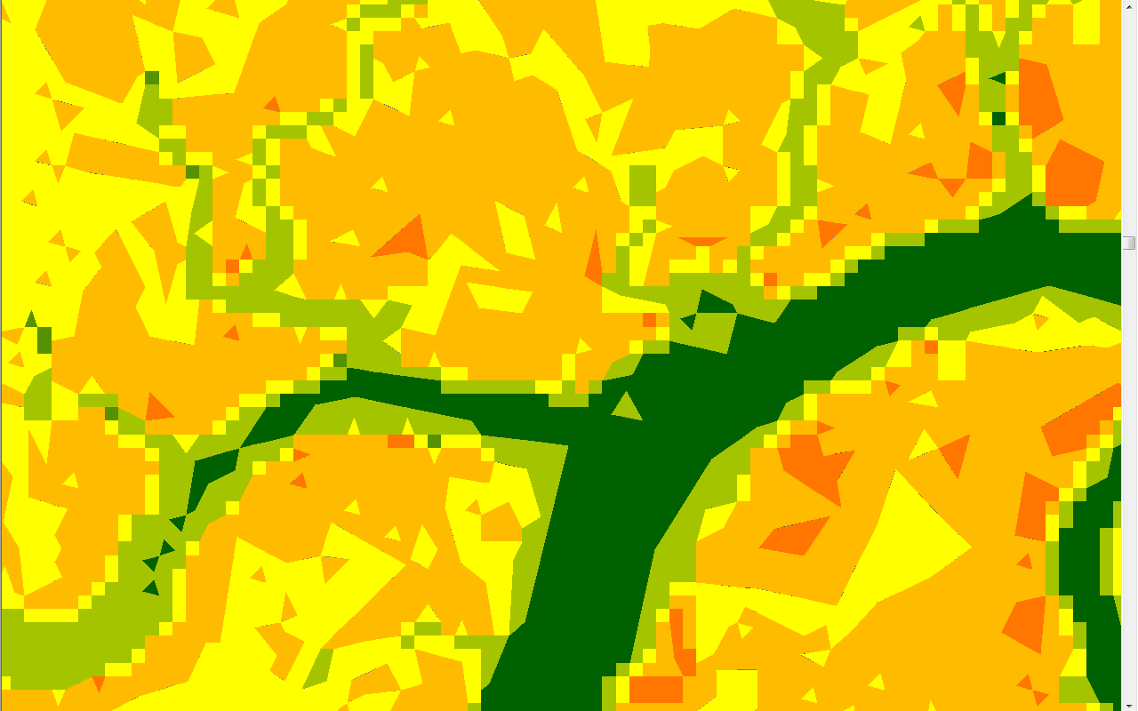
DEMs & Tides
River Distributary Channels
Hand digitized at 1:4,000 scale
Resolves complexity in channel water level surface that otherwise confounds DEM
Identifies essential plumbing of freshwater and sediment
Basis for ‘least cost’ metrics or stratification of sampling or compartmentalizing for sediment study.

Slide 12
DEMs & Tides
MHHW-XHW
MHW-MHHW
MT-MHW
SUPRA-TIDAL

Slide 13
Distributaries
River Distributary Channels
Hand digitized at 1:4,000 scale
Resolves complexity in channel water level surface that otherwise confounds DEM
Identifies essential plumbing of freshwater and sediment
Basis for ‘least cost’ metrics or stratification of sampling or compartmentalizing for sediment study.

Slide 14
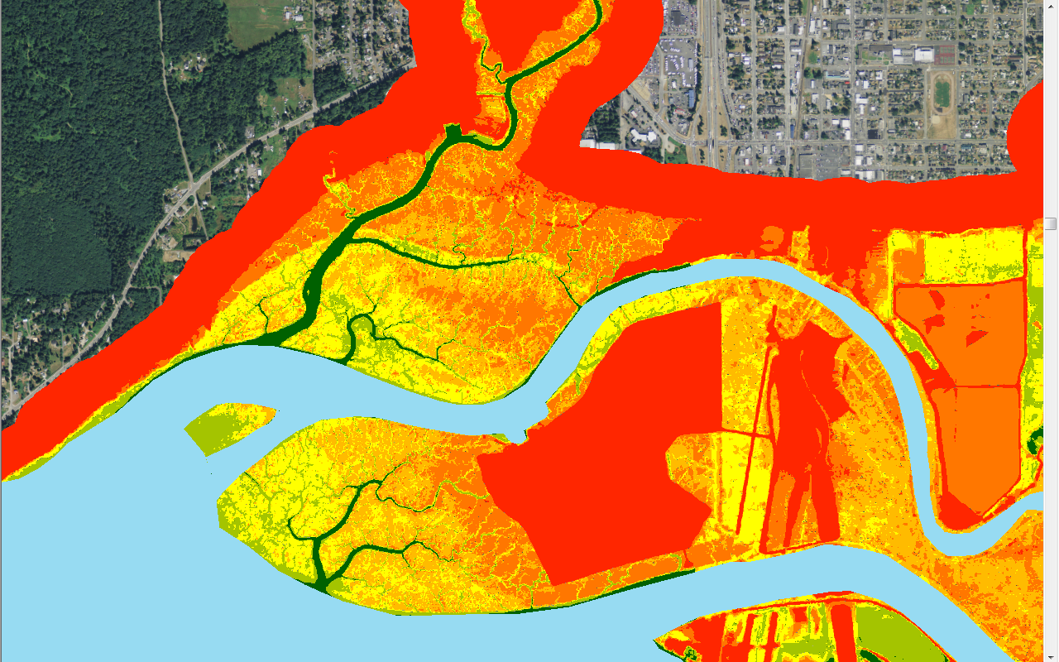
Distributaries
MHHW-XHW
MHW-MHHW
MT-MHW
SUPRA-TIDAL

Slide 15
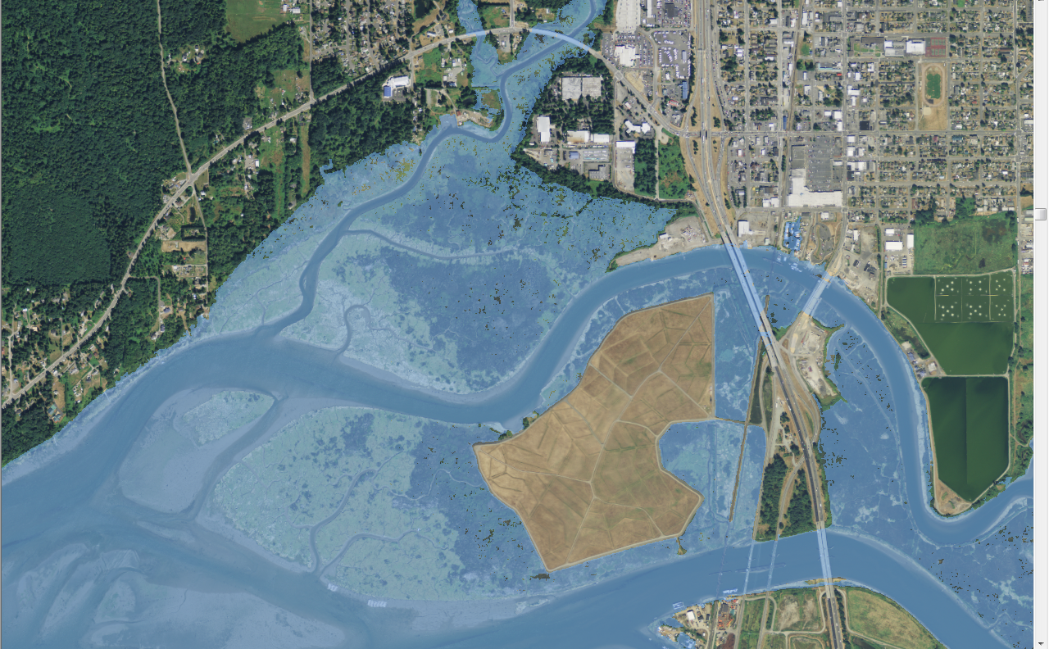
Tidal Flood Zone
River Distributary Channels
Hand digitized at 1:4,000 scale
Resolves complexity in channel water level surface that otherwise confounds DEM
Identifies essential plumbing of freshwater and sediment
Basis for ‘least cost’ metrics or stratification of sampling or compartmentalizing for sediment study.

Slide 16
Tidal Flood Zone
River Distributary Channels
Hand digitized at 1:4,000 scale
Resolves complexity in channel water level surface that otherwise confounds DEM
Identifies essential plumbing of freshwater and sediment
Basis for ‘least cost’ metrics or stratification of sampling or compartmentalizing for sediment study.

Slide 17
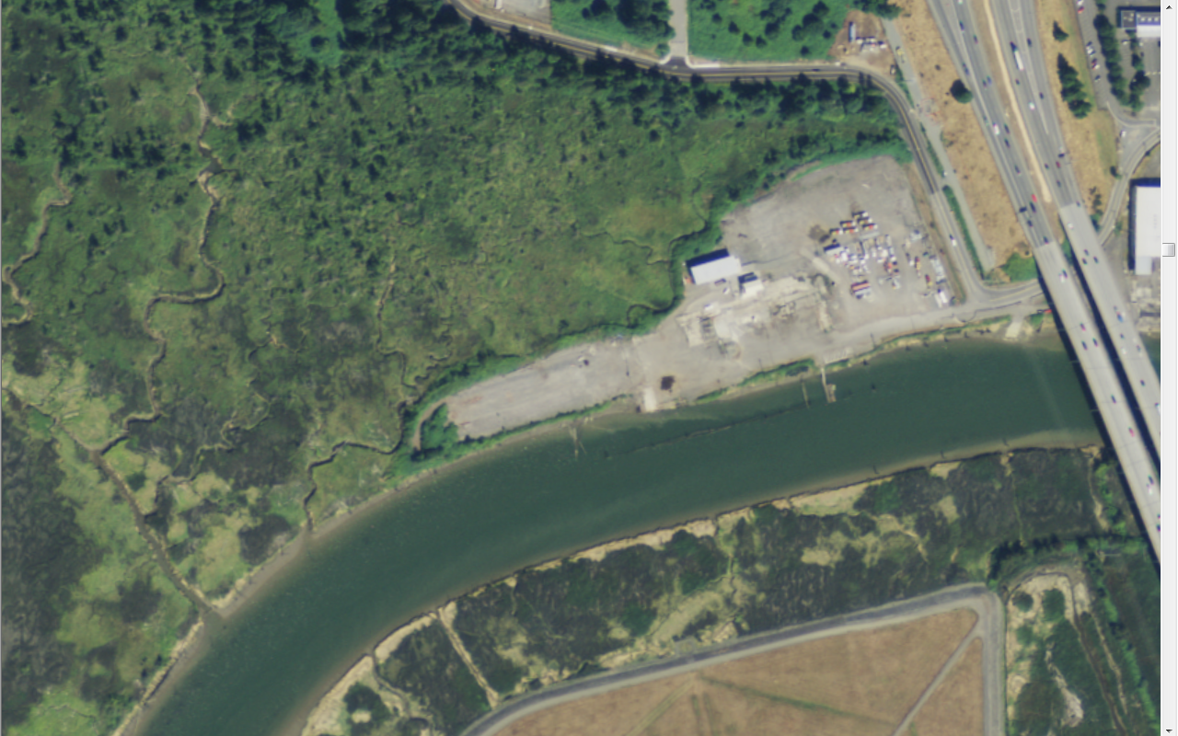
Synthesis

Slide 18
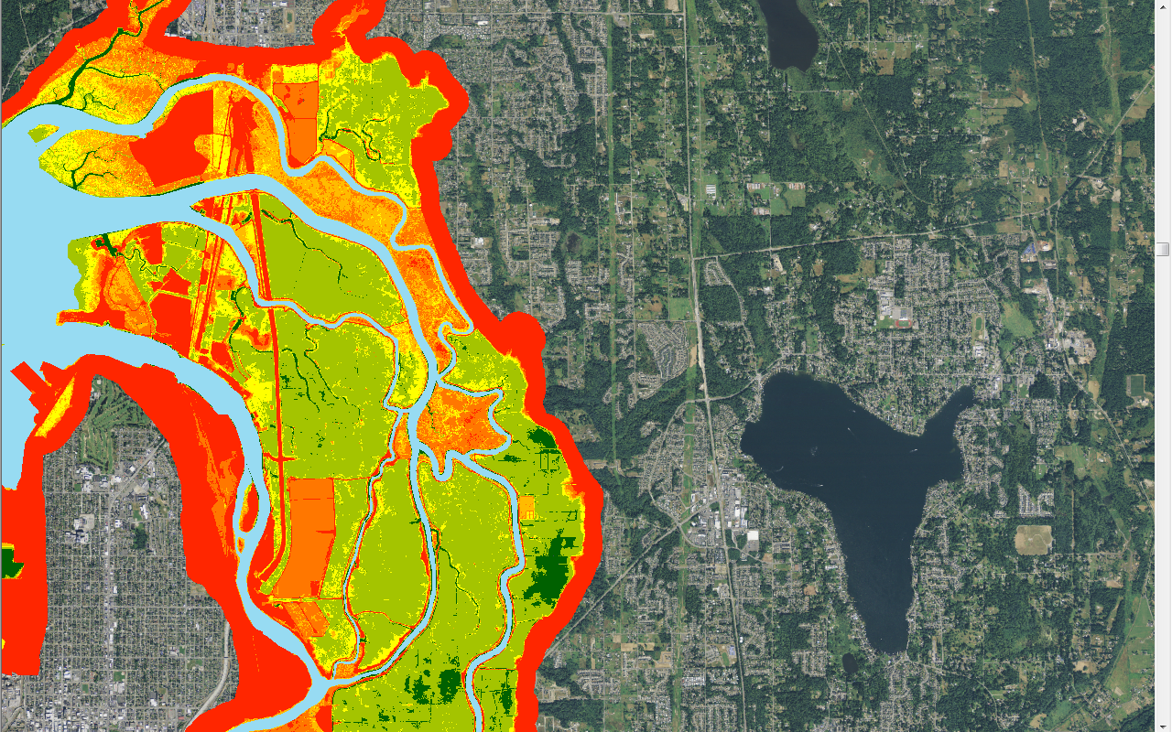
Current Tidal Flood

Slide 19
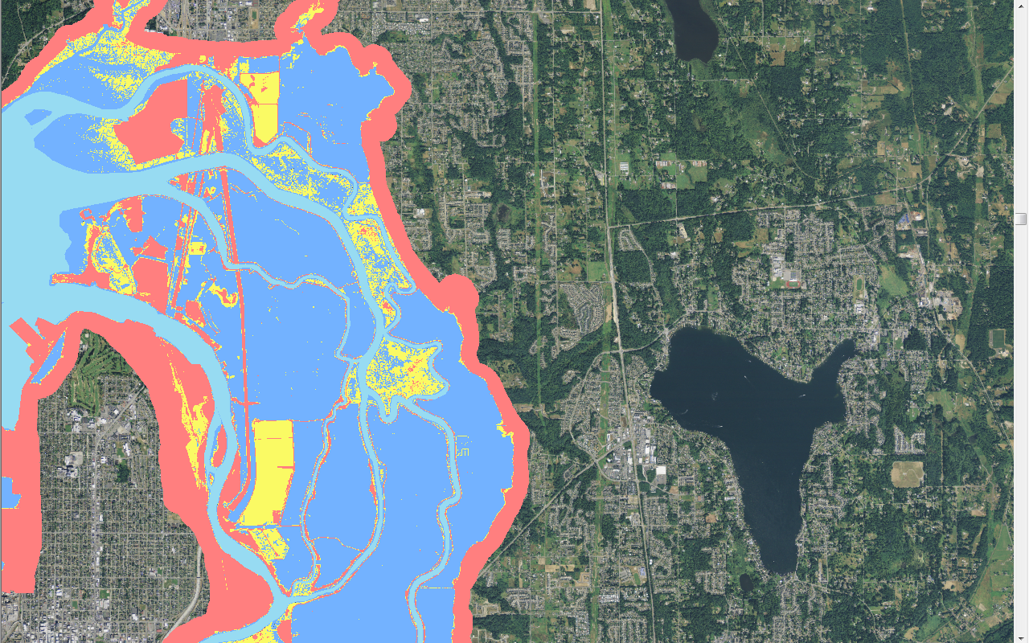
Current Tidal Flood
Distributary
Text
Frequently Flooded
Rarely Flooded
Above Tidal Flood

Slide 20
Current Tidal Flood
Add “distributary channel” to “frequently flooded”
Select the distributary/frequently flooded polygon connected to Puget Sound
Clip off any sites where flood protection doesn’t register on model
Add additional adjacent areas of “rarely flooded”
Clip off any areas where flood protection doesn’t register on model
Result is River Delta area subject to tidal flow

Slide 21
Current Tidal Flood
Distributary
Text
Frequently Flooded
Rarely Flooded
Above Tidal Flood

Slide 22
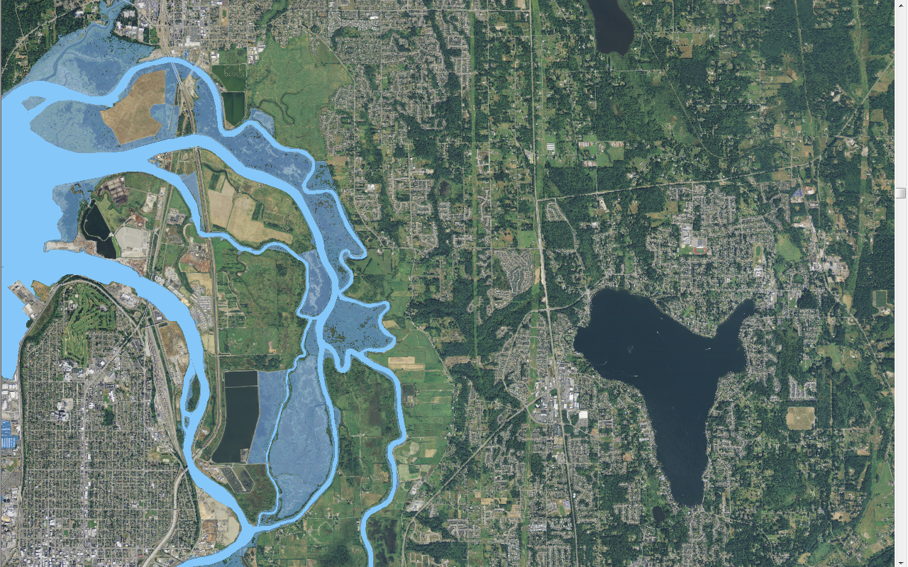
Current Tidal Flood
Text
“Area frequently or rarely flooded connected to a distributary or Puget Sound, with no evidence of flood protection”

Slide 23
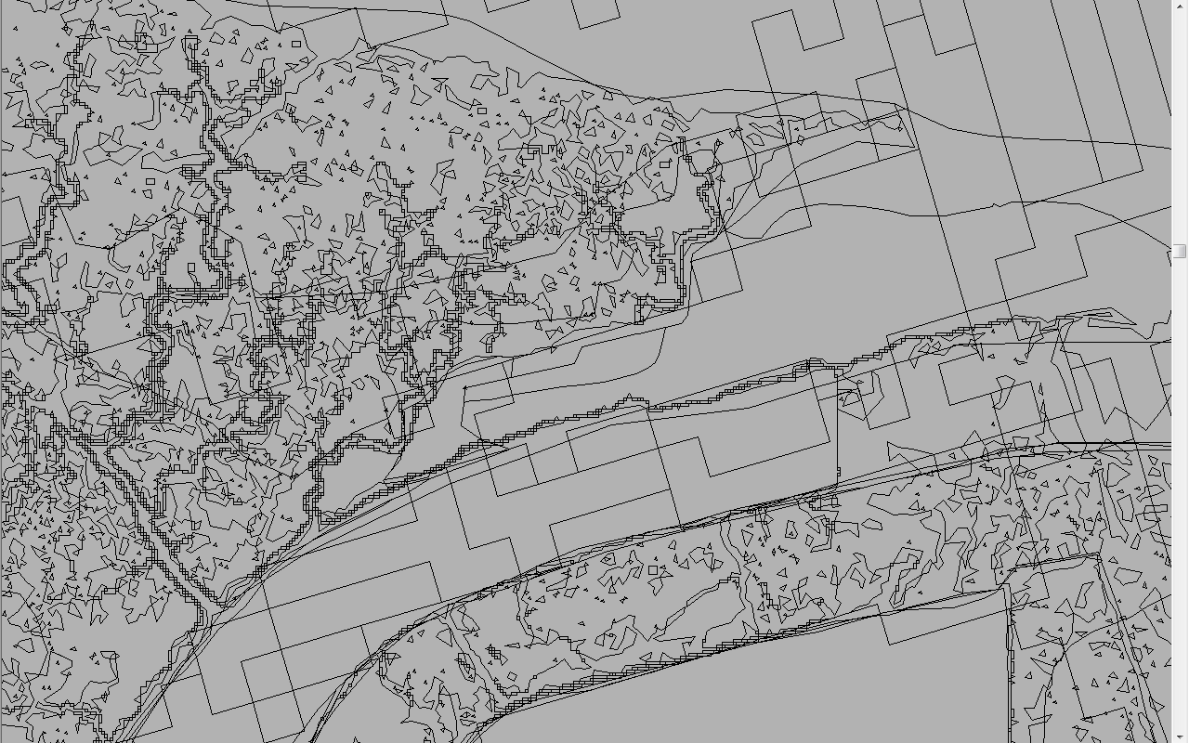
Synthesis
Delta boundary (Simenstad et al. 2011)
Digital elevation models (USGS et al.) & tidal datum (NOAA)
  Estimated potential tidal inundation regime
  Estimated area of current tidal inundation
River distributary channels (NEW)
Current wetland mapping (Simenstad et al. 2011)
Landcover (C-CAP based on LANDSAT 30m)

Slide 24
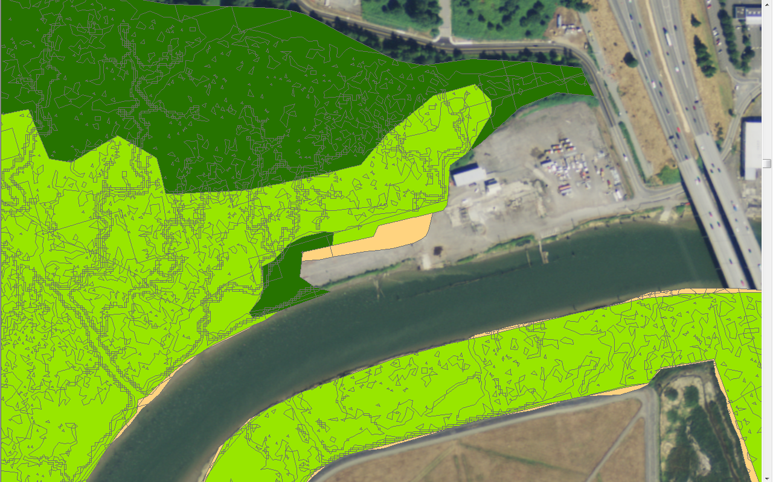
Synthesis
Delta boundary (Simenstad et al. 2011)
Digital elevation models (USGS et al.) & tidal datum (NOAA)
  Estimated potential tidal inundation regime
  Estimated area of current tidal inundation
River distributary channels (NEW)
Current wetland mapping (Simenstad et al. 2011)
Landcover (C-CAP based on LANDSAT 30m)

Slide 25
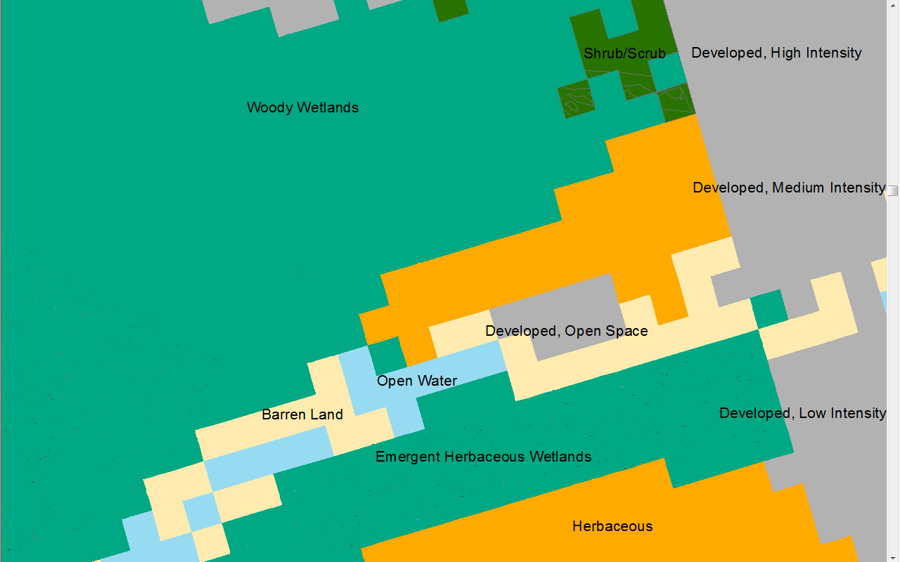
Synthesis
Delta boundary (Simenstad et al. 2011)
Digital elevation models (USGS et al.) & tidal datum (NOAA)
  Estimated potential tidal inundation regime
  Estimated area of current tidal inundation
River distributary channels (NEW)
Current wetland mapping (Simenstad et al. 2011)
Landcover (C-CAP based on LANDSAT 30m)

Slide 26
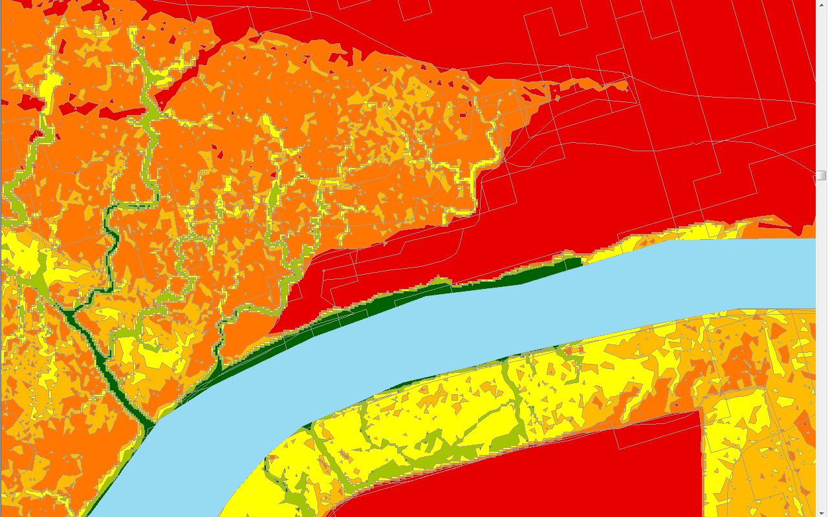
Synthesis
Delta boundary (Simenstad et al. 2011)
Digital elevation models (USGS et al.) & tidal datum (NOAA)
  Estimated potential tidal inundation regime
  Estimated area of current tidal inundation
River distributary channels (NEW)
Current wetland mapping (Simenstad et al. 2011)
Landcover (C-CAP based on LANDSAT 30m)

Slide 27
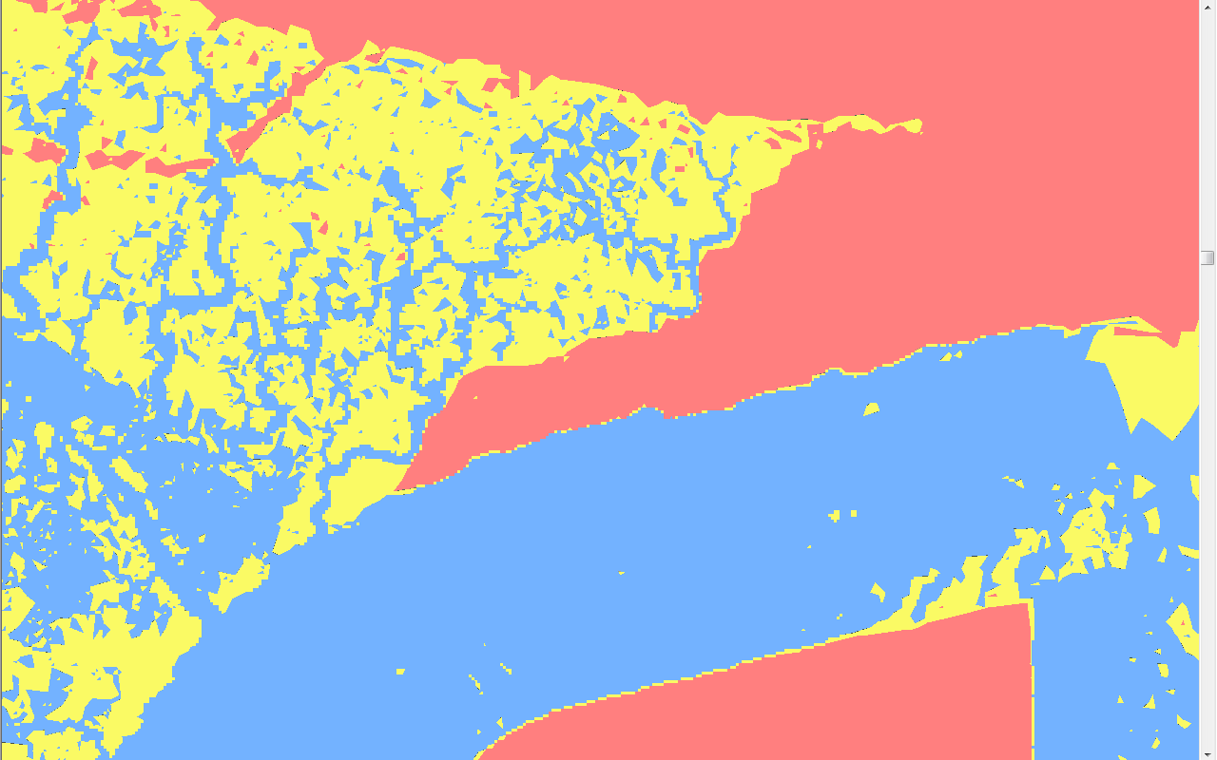
Synthesis
Delta boundary (Simenstad et al. 2011)
Digital elevation models (USGS et al.) & tidal datum (NOAA)
  Estimated potential tidal inundation regime
  Estimated area of current tidal inundation
River distributary channels (NEW)
Current wetland mapping (Simenstad et al. 2011)
Landcover (C-CAP based on LANDSAT 30m)

Slide 28
Synthesis
Delta boundary (Simenstad et al. 2011)
Digital elevation models (USGS et al.) & tidal datum (NOAA)
  Estimated potential tidal inundation regime
  Estimated area of current tidal inundation
River distributary channels (NEW)
Current wetland mapping (Simenstad et al. 2011)
Landcover (C-CAP based on LANDSAT 30m)

Slide 29
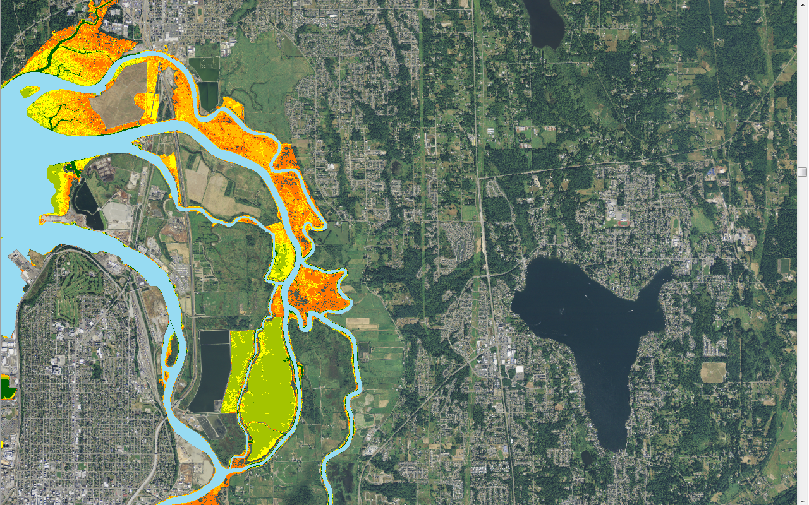
Synthesis
Text

Slide 30
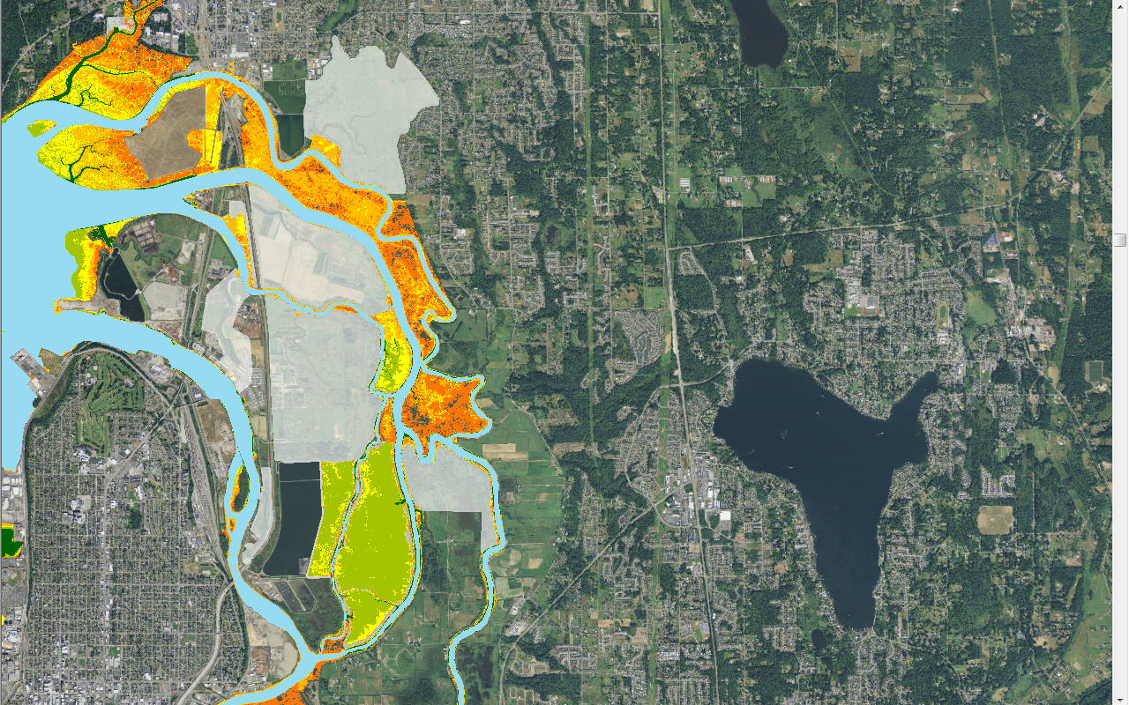
Synthesis
Text

Slide 31
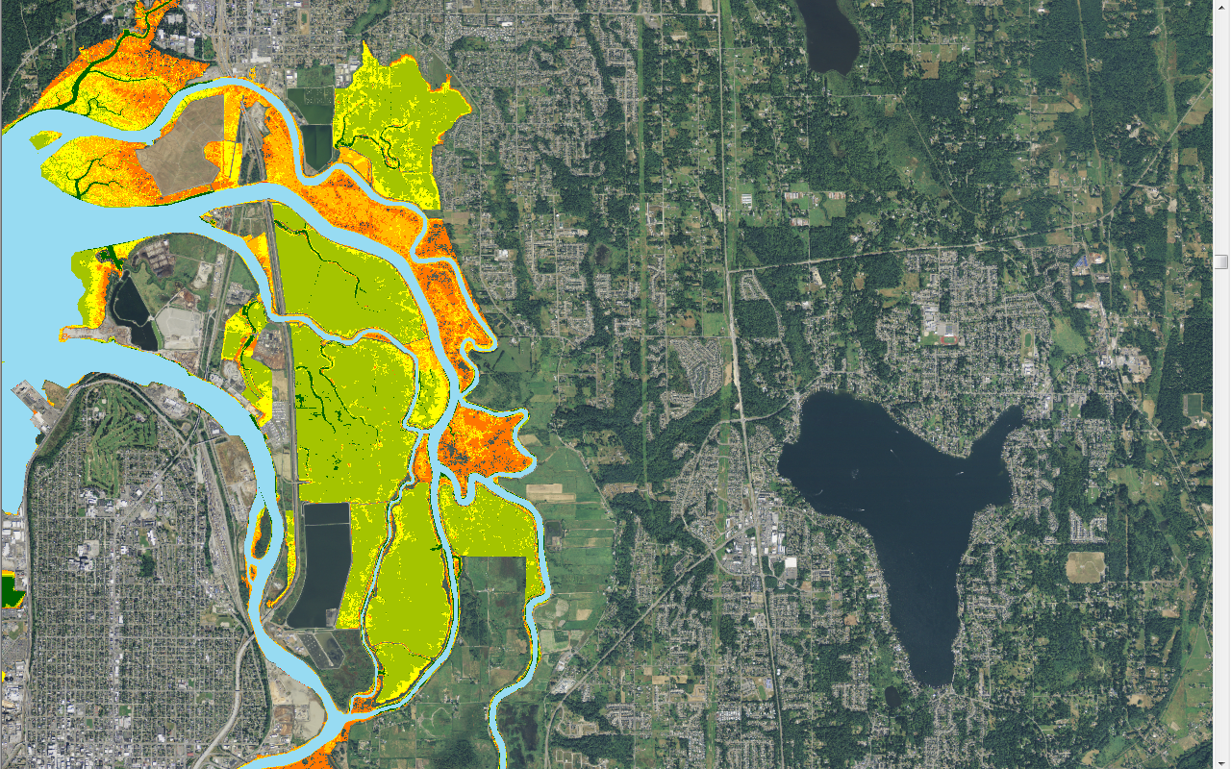
Synthesis
Text

Slide 32
Findings
C-CAP landcover (and change analysis) is useless except at large scales
  Aerial photo interpretation could be trained for delta settings (K. Pierce; WDFW)
Elevation models appear to provide better description of vegetation than current wetland delineations
  Next generation DEMs are superior, and require ground validation for risk analysis (weak spots in dikes, future vegetation)
  No sensitivity analysis or even current error calculation has been developed.
Identification of a repeatable and relatively accurate “predicted area of tidal flood” is viable
Substantial area of diked river deltas appear to have subsided below levels predicted to reliably support vegetation.
  restoration is DEPENDENT on sediment routing

Slide 33
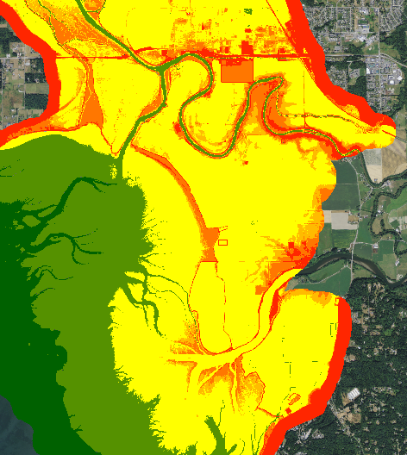
Findings
Simenstad DPU bad fit for current delta elevations

Slide 34
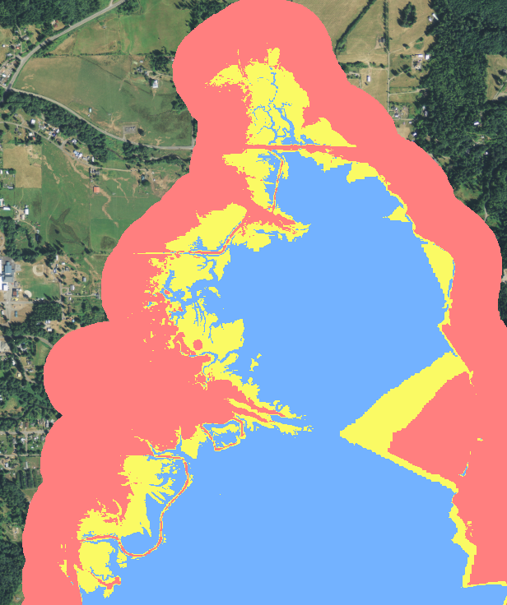
Findings
Simenstad DPU bad fit for current delta elevations in some locations
DEMs introduce substantial error in some situations—possible “work-arounds” for delta restoration purposes

Slide 35
Purpose
Compile Data Layers to develop a basis for:
Measuring – Anticipate no problem in “important deltas”, some DEM problems—fall back on Simenstad.
  Lost but not gone – DUW, PUY
  Big Question – DES, SAM
  Good shape, plus freeway – DOS, DUC, HAM
  Early successes, still some work to do – SKO, NSQ, QUL, DUN
  Great flux - ELW
  The Great Effort – SNO, STL, SKG, NKS
Tracking – Current shapes are rough. Need review and refinement process. Still stuck with acres, but improved by elevations.
Evaluating -- Potential to replace veg monitoring with remote sensing, highlights focus on alluvial sediment processes.

